Slide 1
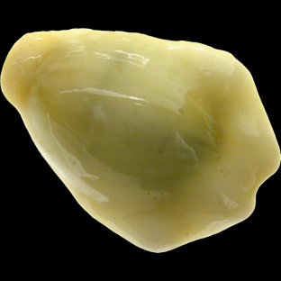
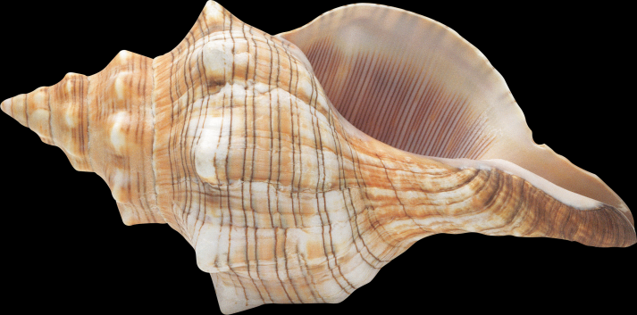
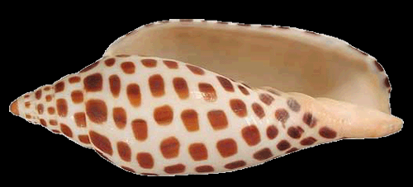
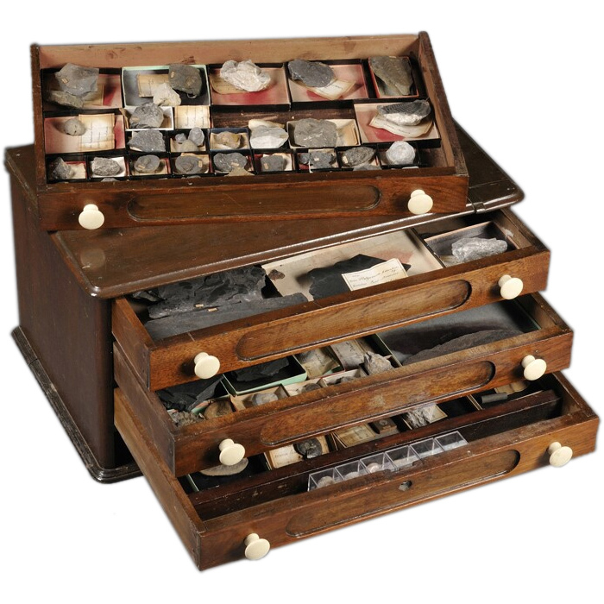
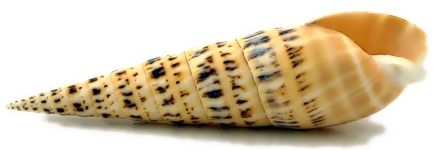
Cataloguing Shells
…the complicated way.
Andre Meredith – SCSA – Pretoria Club – May 2018

Slide 2
Definition
Catalogue:
to make a systematic list of (items of the same type). – Google Dictionary
a list or record, systematically arranged and often including descriptive material – Dictionary.com
a list of things such as the goods you can buy from a particular company, the objects in a museum, or the books in a library. – Collins Dictionary
a list or itemized display, as of titles, course offerings, or articles for exhibition or sale, usually including descriptive information or illustrations. – The Free Dictionary
A complete list of items, typically one in alphabetical or other systematic order. – Oxford Dictionary

Slide 3
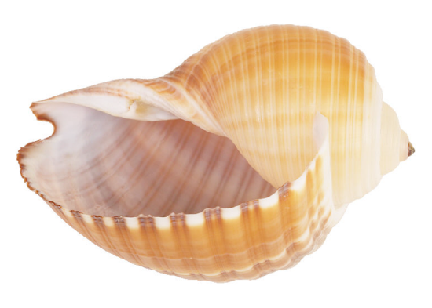
The Key
There has to be some way of linking:
The physical shell
to
The shell information
Figure out the way that works best for YOU!

Slide 4
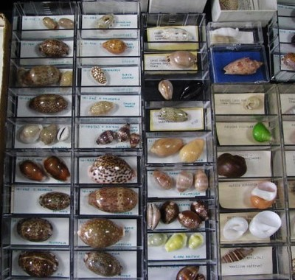
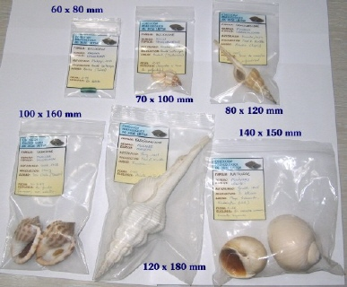
The Traditional Way

Slide 5
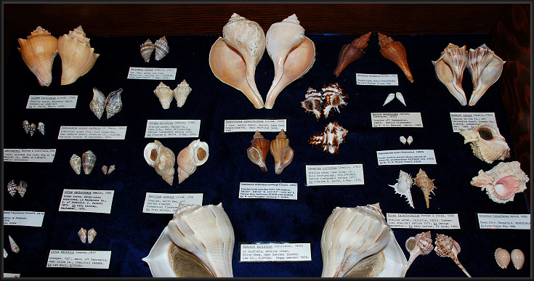
The Traditional Way

Slide 6
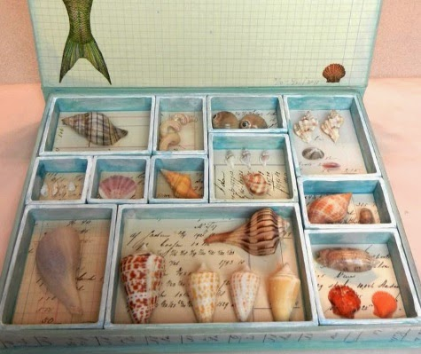
The Traditional Way

Slide 7
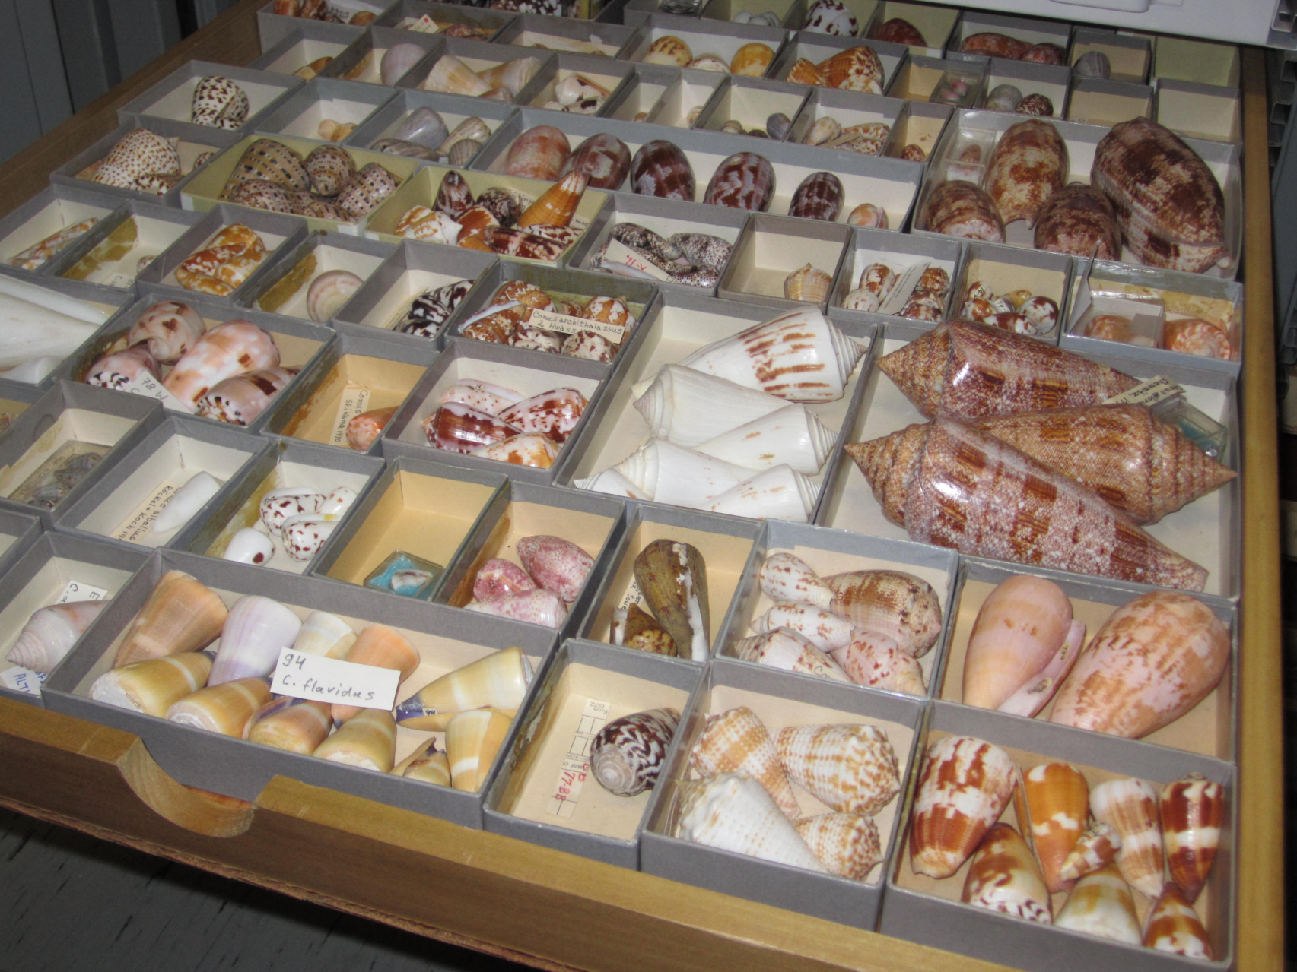
The Traditional Way

Slide 8
The Complicated Way…
This is the method I chose.
It is somewhat time consuming, but works for me.
It may not work for you – it is up to you!

Slide 9
The Primary Difference
Digital
not
Paper

Slide 10
Initial Setup
Decide: Cloud or Local
Create Folder Structure
Family
Genus
Species + Subspecies + forms
Leave room for expansion!

Slide 11
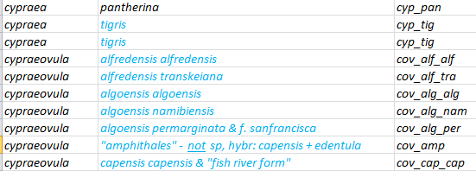
Initial Setup
Create Unique Numbering System
At lowest level: gen_spe_sub
Erosaria citrina citrina: ero_cit_cit
Erosaria citrina dauphinensis: ero_cit_dau
Erronea caurica elongata: err_cau_elo
Talostolida teres natalensis: tal_ter_nat
Talparia exusta: tlp_exu

Slide 12
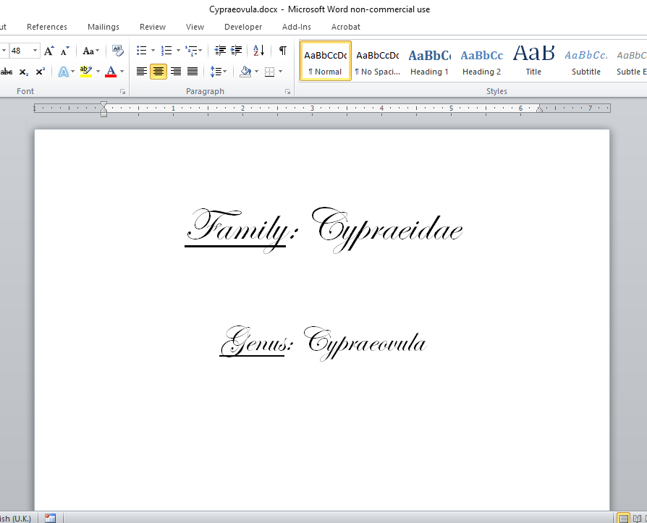
Initial Setup
Create MS Word Forms
1x Document per Genus

Slide 13
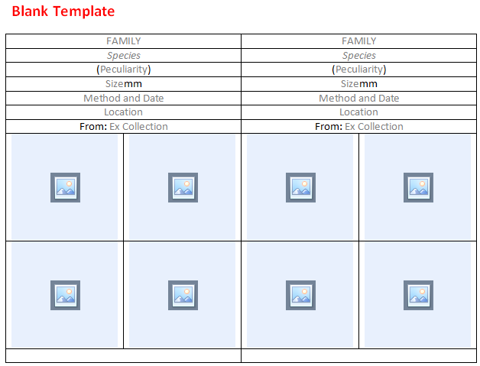
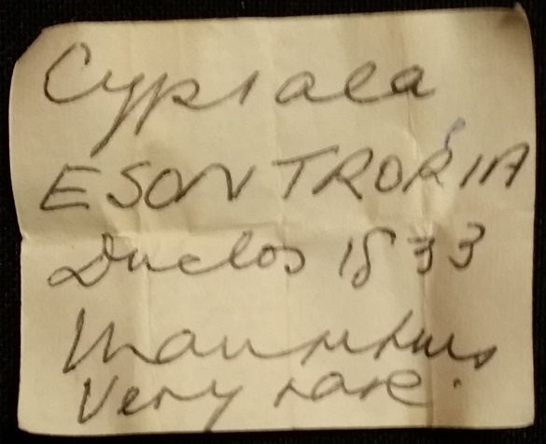
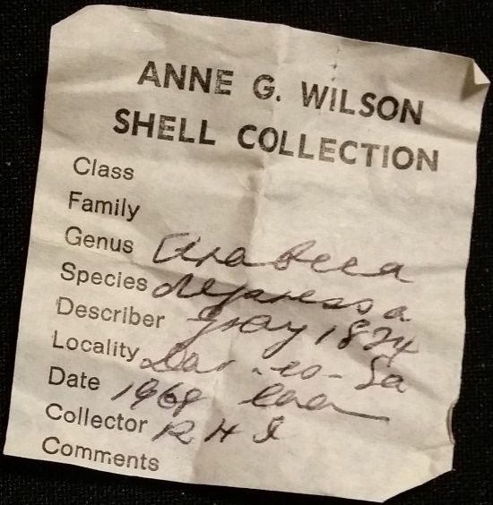
Initial Setup
Create blank template per species, subspecies or form (as you choose)

Slide 14
Initial Setup
(Minimum) “label” information:
Size
Photos
Family
Author and year
Collection Date
Collection Locality
Collection Method
Unique identifier
Previous owner / seller name
Genus + species / subspecies name
Any defining peculiarities or other facts

Slide 15
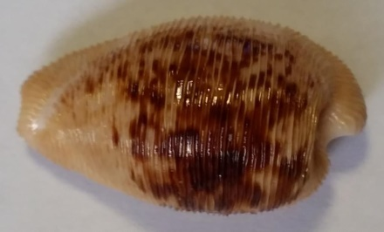
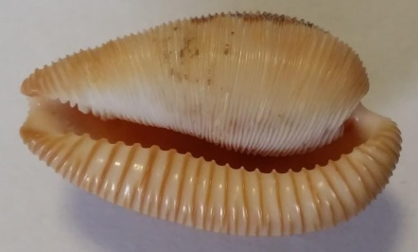
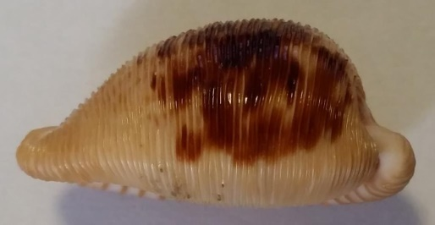
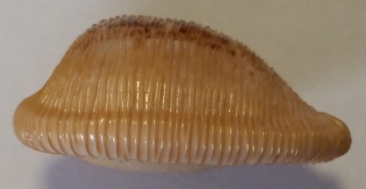
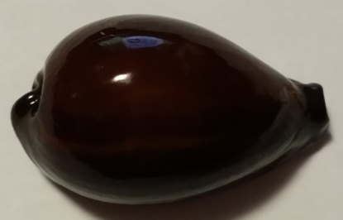
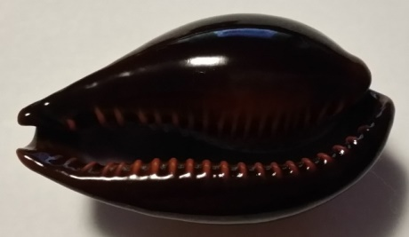
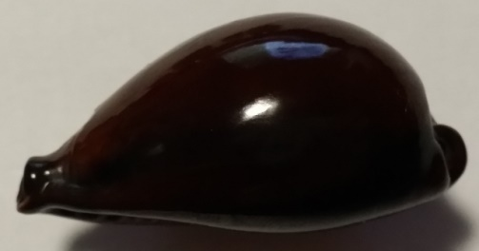
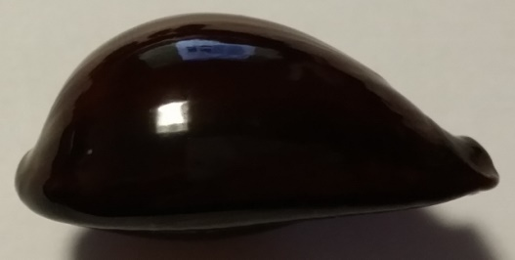
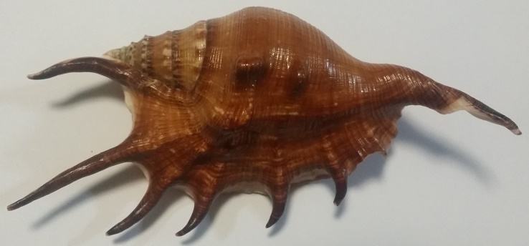
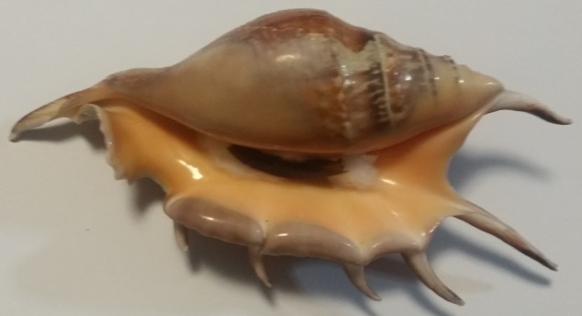
Cataloguing Process
Step 1: Take and crop photos
Enough to help with later ID

Slide 16
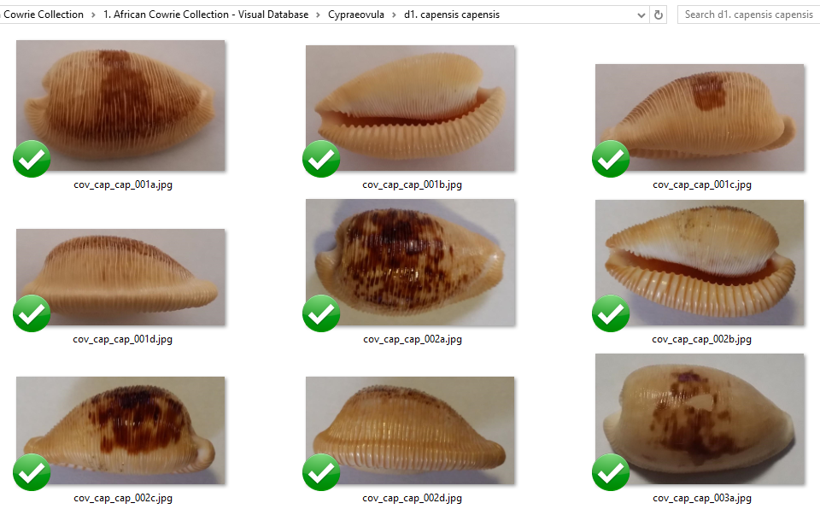
Cataloguing Process
cov_cap_cap_002a.jpg
Step 2: Rename Images

Slide 17
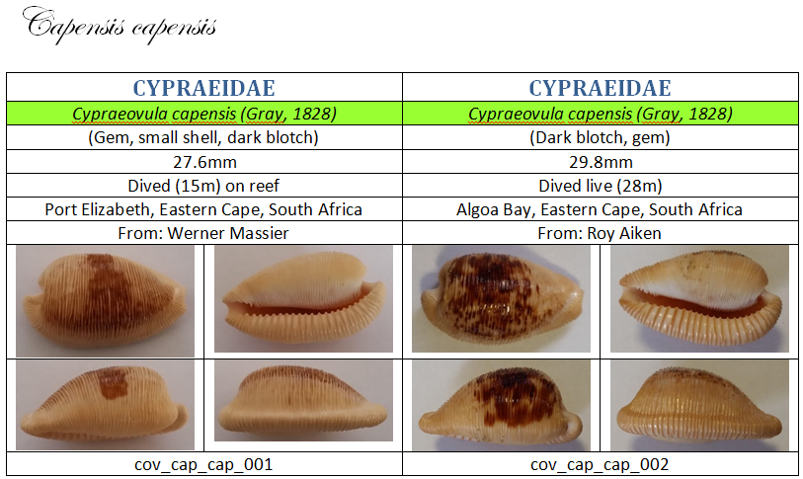
Cataloguing Process
Step 3: Complete Template

Slide 18
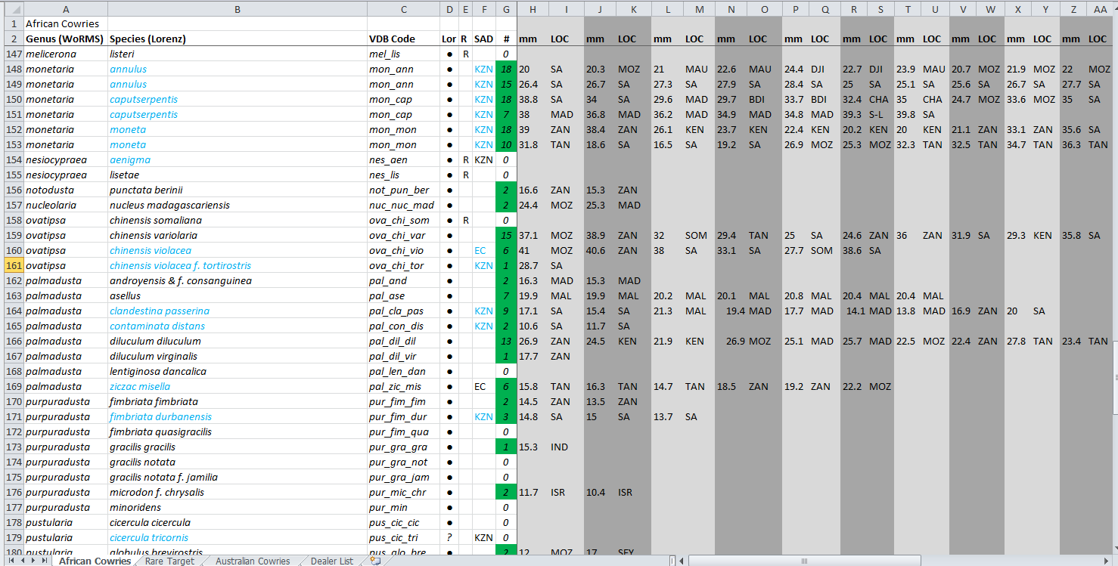
Cataloguing Process
Flat List

Slide 19
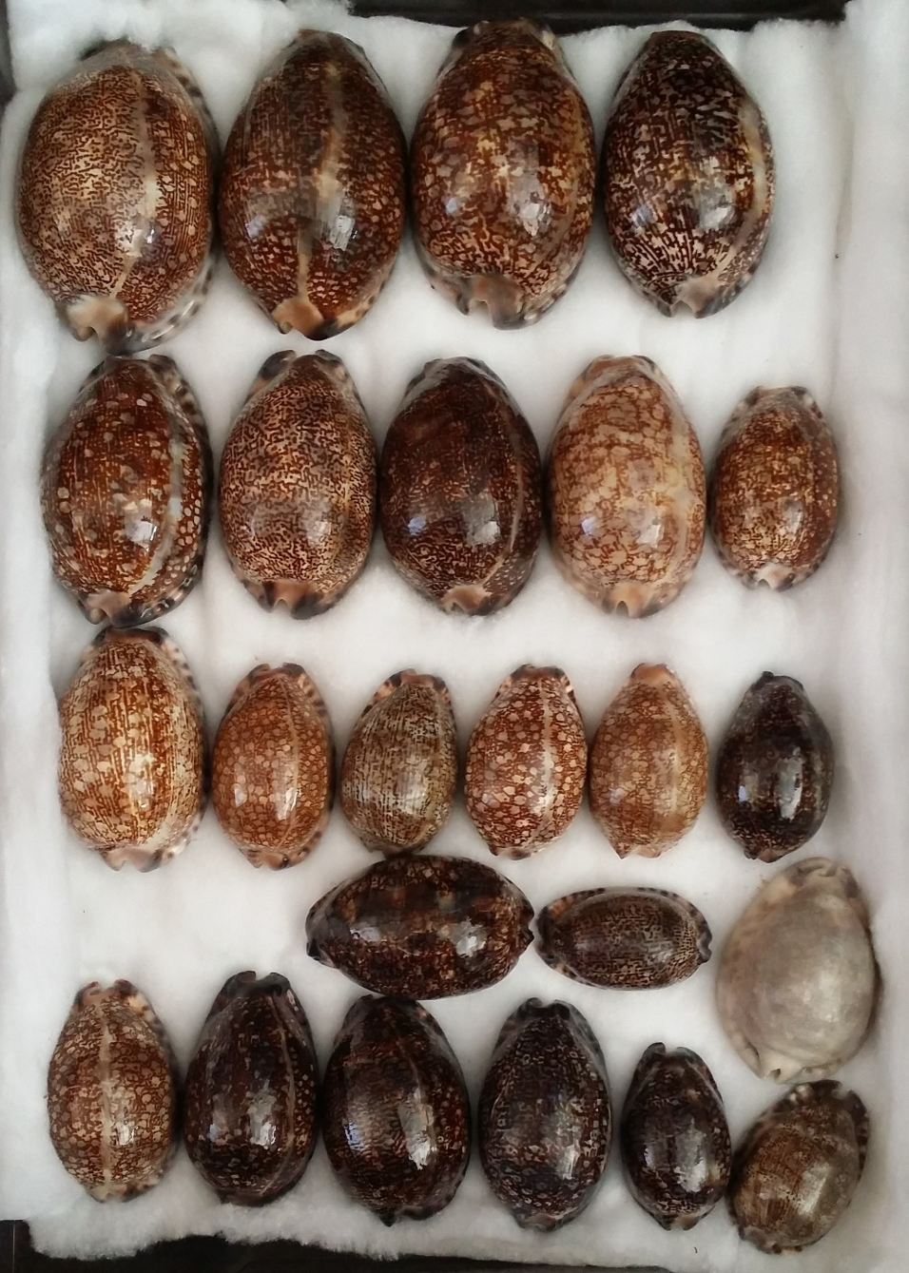
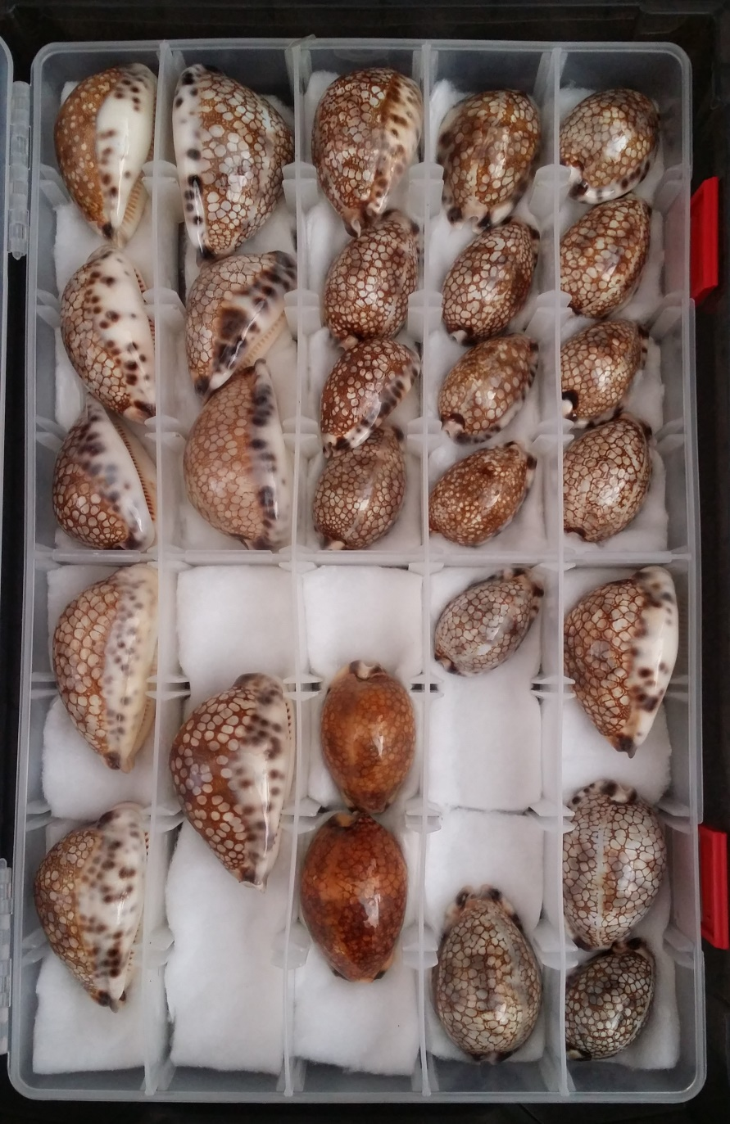
My Shell Drawers
arabica group
histrio group

Slide 20
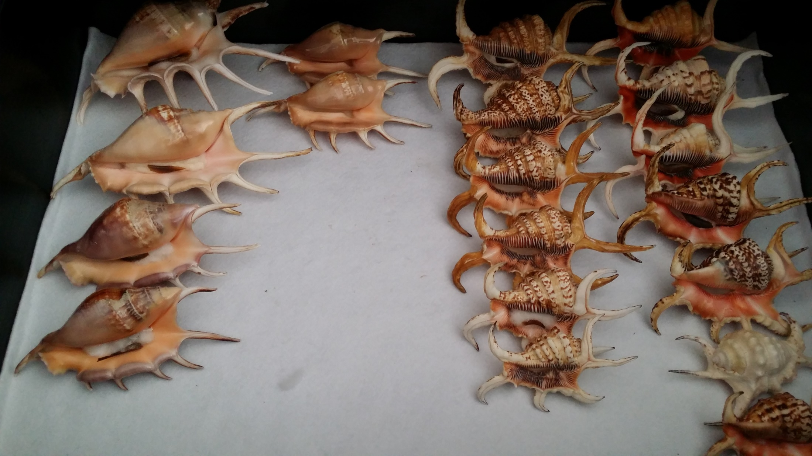
My Shell Drawers
lambis and harpago groups

Slide 21
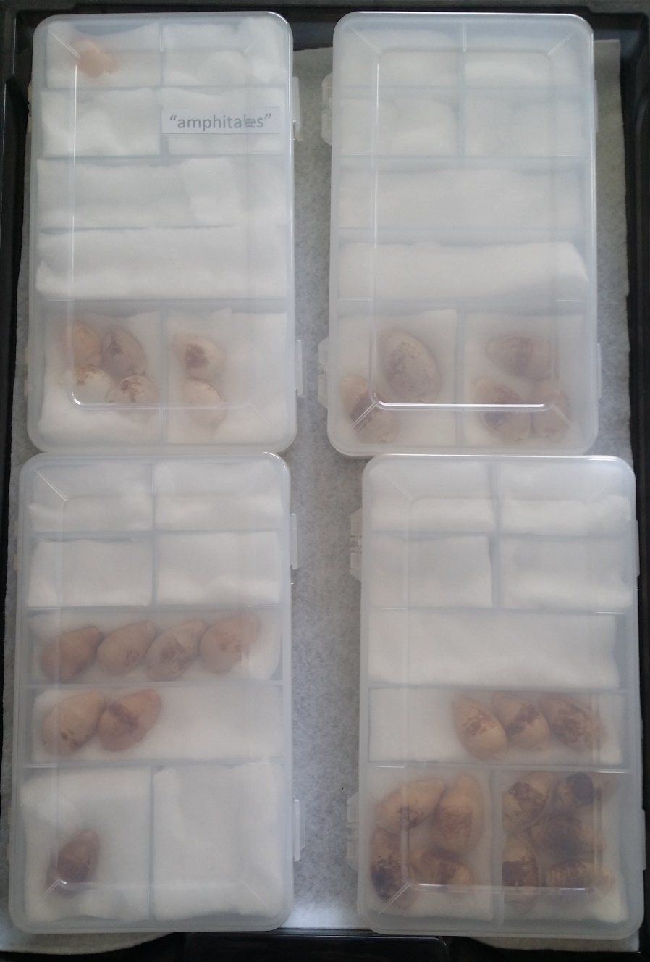
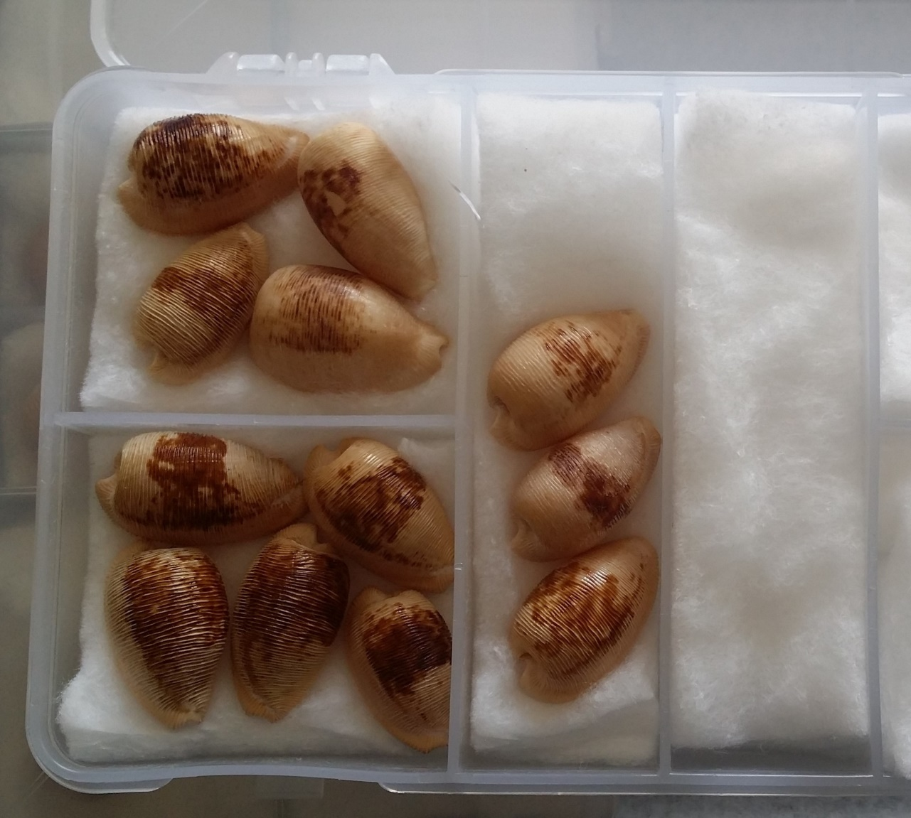
My Shell Drawers
Cypraeovula capensis group
cov_cap_cap_002

Slide 22
Equipment/Tools
Computer
Cloud Storage
MS Word (or equivalent)
Cell Phone
Office Image Editor (or equivalent)
MS Excel (optional)
Temp storage for old labels

Slide 23
Pros and Cons
Cons
Pros
Time to set up.
Time to catalogue.
Time to make visual ID.
Provenance.
Resale challenges.
No paper.
Available anywhere.
All shells photographed.
No degradation.
“Clean” drawers.
Smaller form factor.
Easier to transport.
No mismatching.

Slide 24
Questions?

