Slide 1
Cowries of South Africa
By Andre Meredith

Slide 2
The Immediate Response…
…Cypraeovula.
Cypraovula coronata gloriosa Shikama, 1971

Slide 3
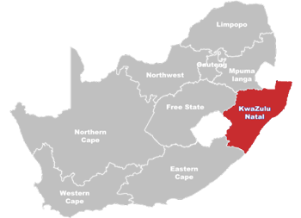
…but we do have other Cowries, too!
Most found along KZN Coast.
The most southern variations of other Indian Ocean species.
Most are common in Indian Ocean, but uncommon to rare in SA waters.

Slide 4
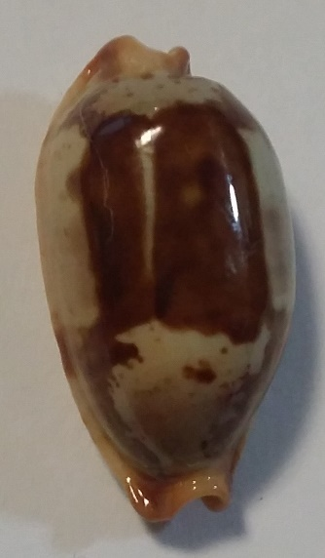
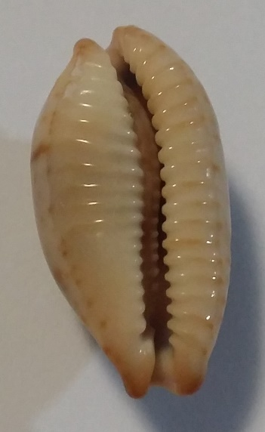
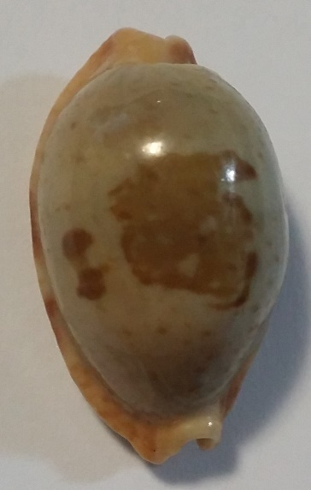
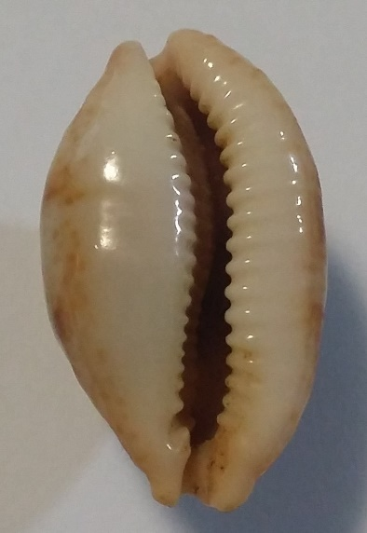
Bistolida
diauges
uvongoensis
owenii vasta
Bistolida stolida stolida, 27.6mm
Dredged 98m, Mfazazaan, KZN
Bistolida stolida uvongoensis, 29.7mm
Dived 40ft, St Lucia, KZN
* endemic

Slide 5
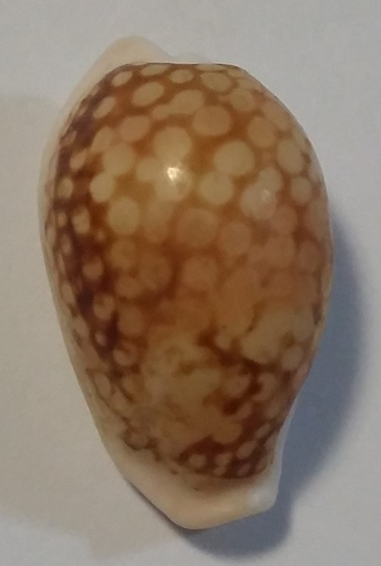
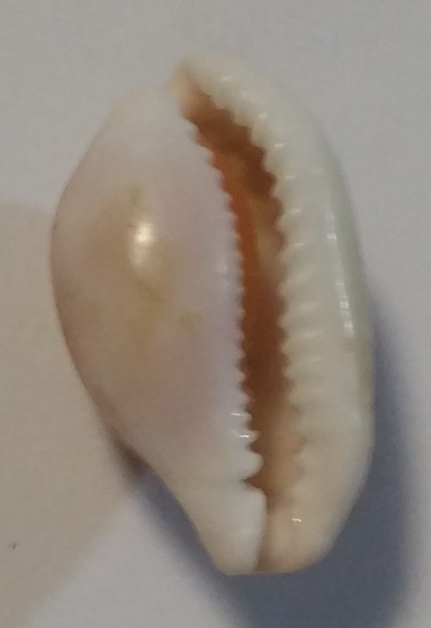
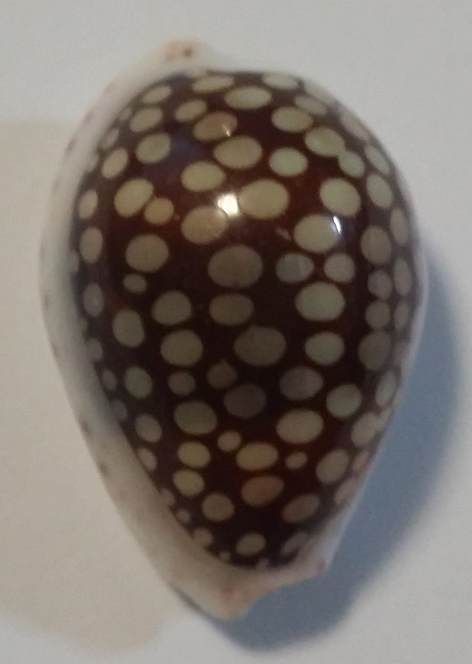
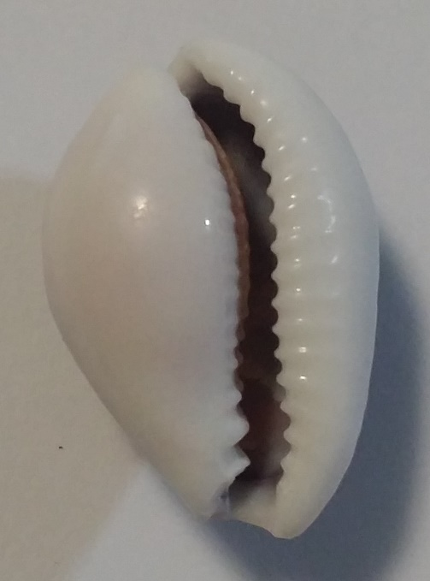
Cribrarula
cribraria cribraria
cribraria setepausensis
esontropia francescoi
Cribrarula cribraria cribraria, 25.6mm
Ex Pisce, Richards Bay, KZN
Cribrarula esontropia francescoi, 28.9mm,
Beach collected, Ballito, KZN

Slide 6
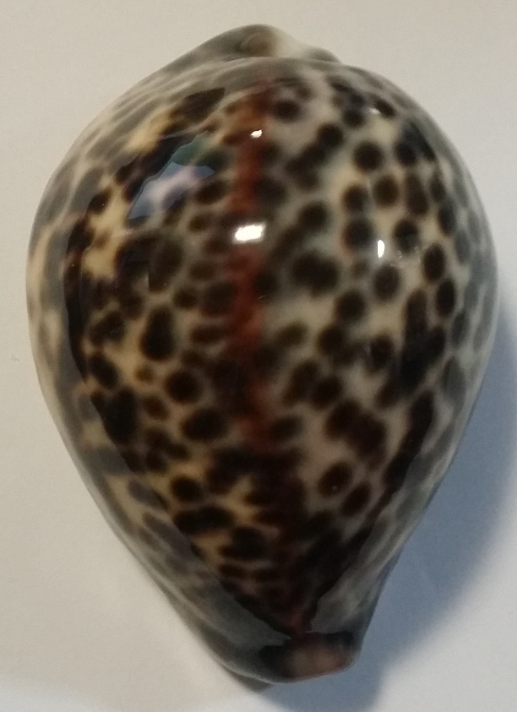
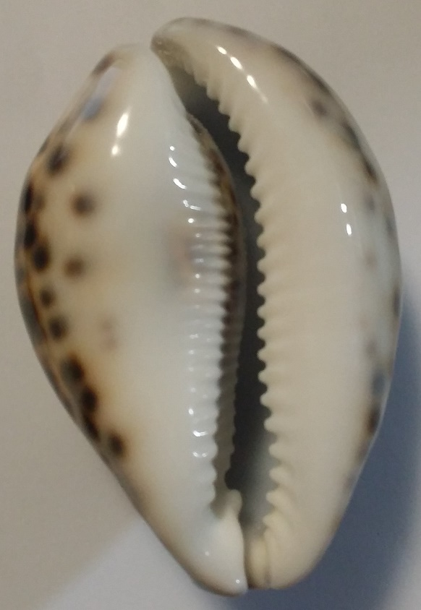
Cypraea
tigris
Cypraea tigris, 84.6mm
Dived 18m, Durban Bay, KZN

Slide 7
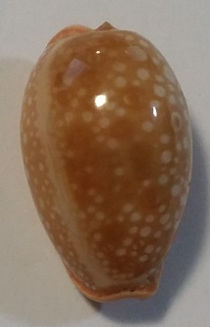
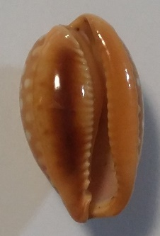
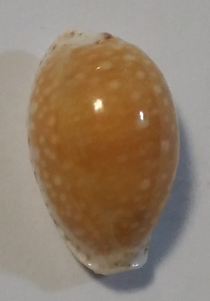
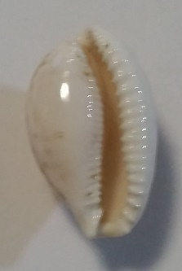
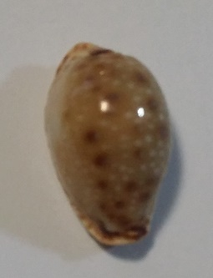
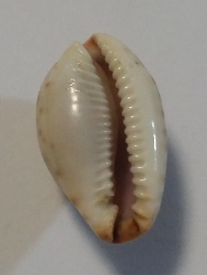
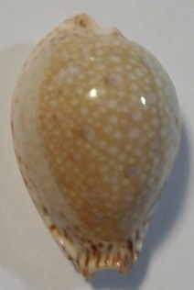
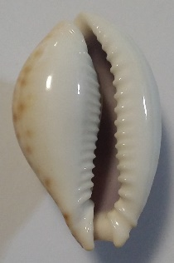
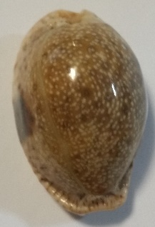
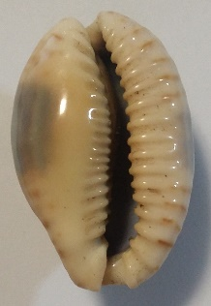
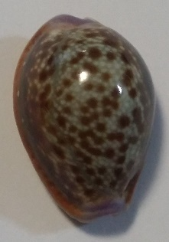
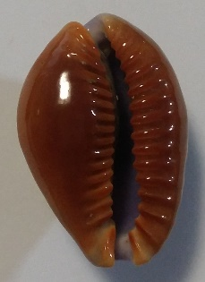
Erosaria
beckii
lamarckii
erosa
citrina
cernica
marginalis
helvola argella
helvola meridionalis
gangranosa
Erosaria citrina, 26.8mm
Dived, Hibberdene, KZN
Erosaria cernica, 22mm
Dredged, Southern KZN
Erosaria gangranosa, 22.6mm
Ex Pisce, Richards Bay, KZN
* endemic
Erosaria lamarcki, 37.9mm
Durban Bay, KZN
Erosaria erosa, 45.3mm
KZN
Erosaria helvola, 28.5mm
Mtwalume, KZN

Slide 8
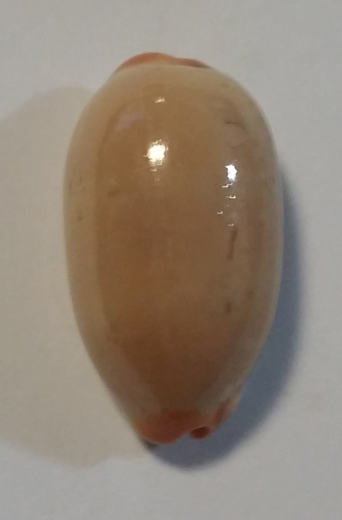
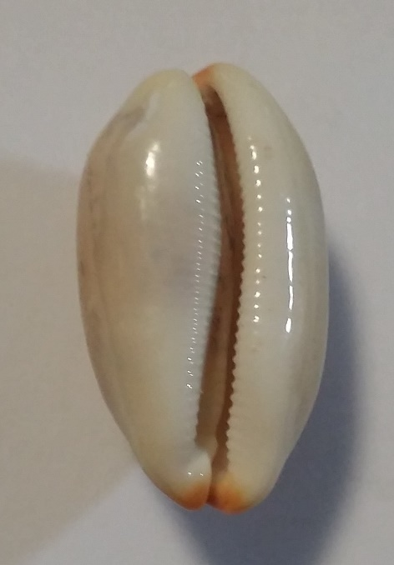
Luria
isabella
Luria Isabella, 32.8mm
KZN

Slide 9
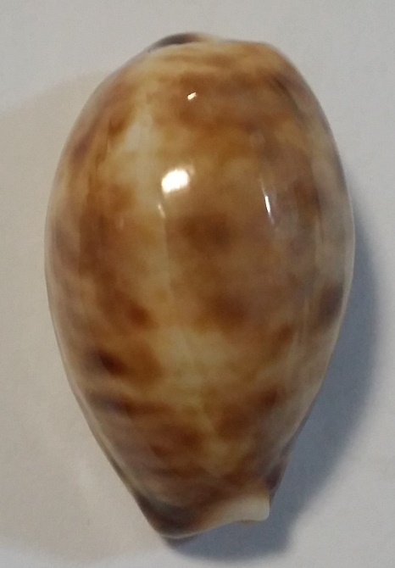
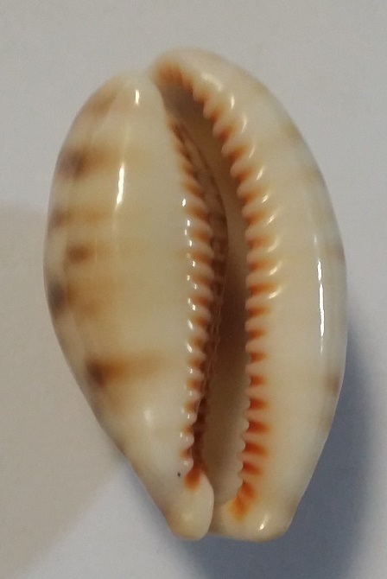
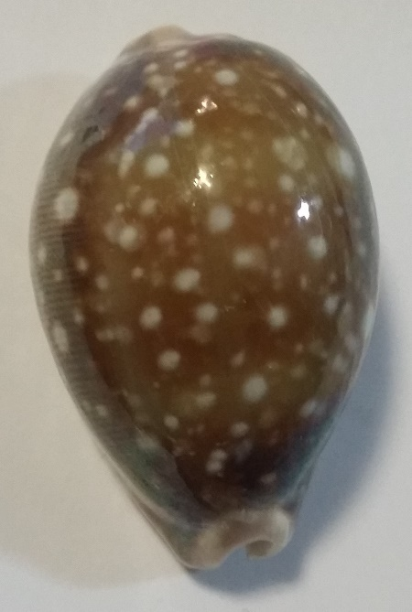
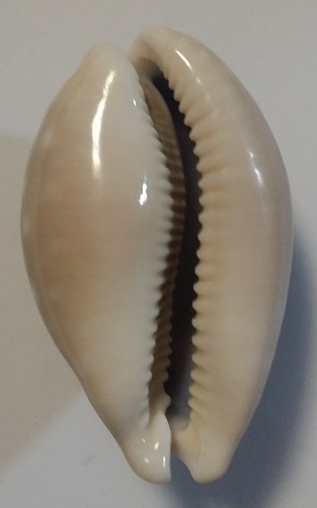
Lyncina
lynx
vitellus
carneola
leviathan titan
Lyncina lynx, 35.9mm
Rock pool, Mzamba, KZN
Lyncina vitellus, 53.2mm
Dived 28m, Durban, KZN

Slide 10
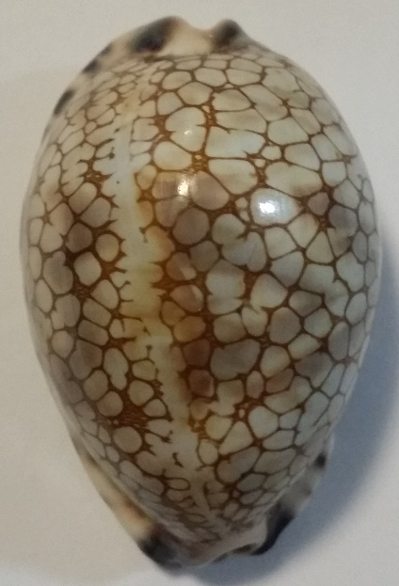
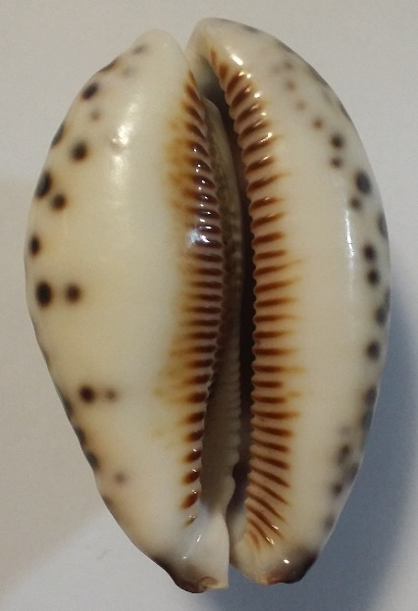
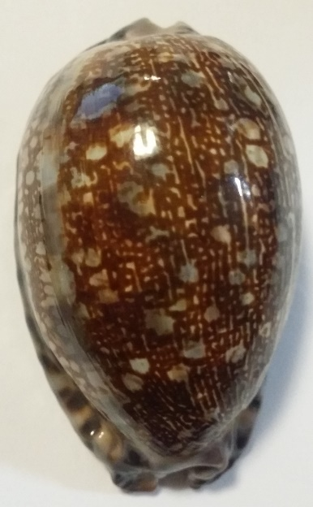
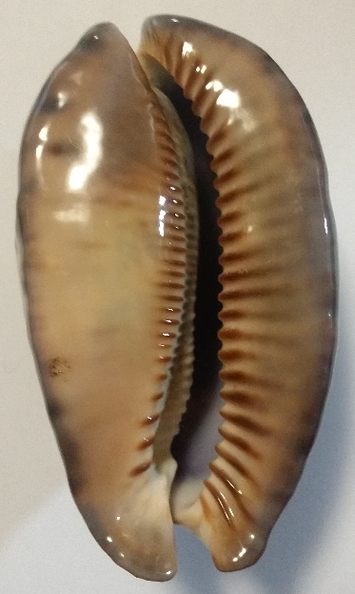
Mauritia
arabica immanis
scurra
histrio
Mauritia histrio, 59.6mm
Dived 18m, Warner Beach, KZN
Mauritia arabica immanis, 83.1mm
Low underhangs, Park Rynie, KZN

Slide 11
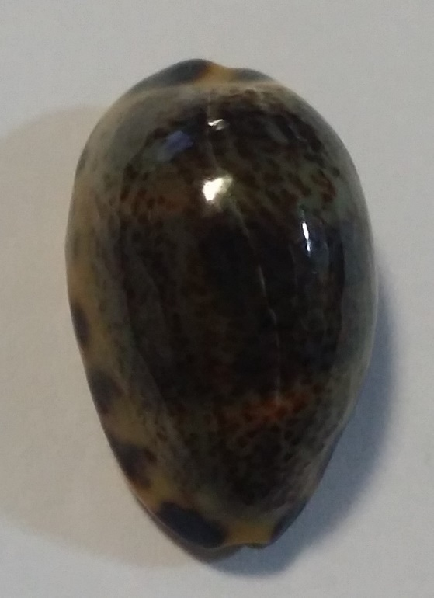
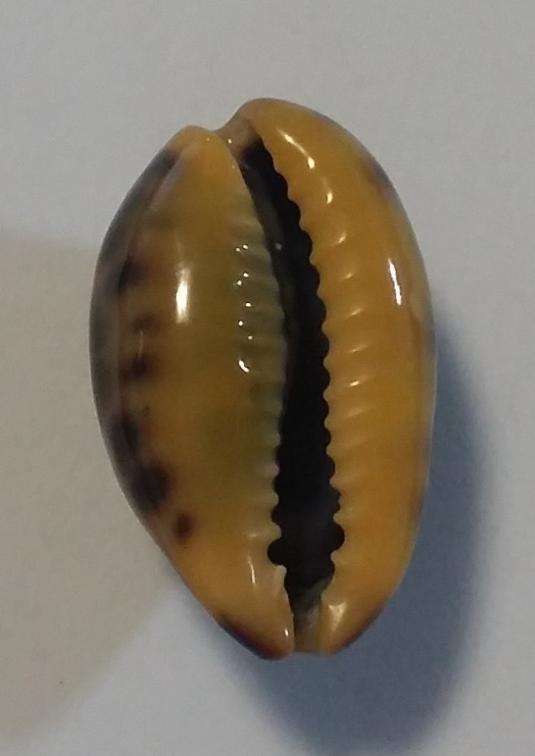
Melicerona
felina
Melicerona felina, 22.8mm
Dived, Hibberdene, KZN

Slide 12
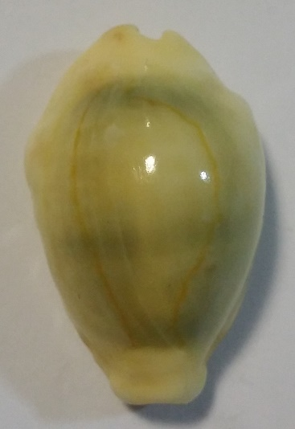
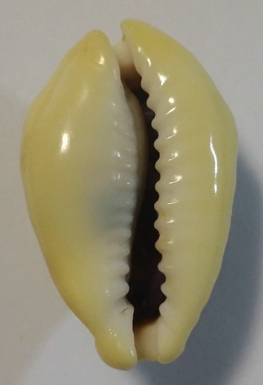
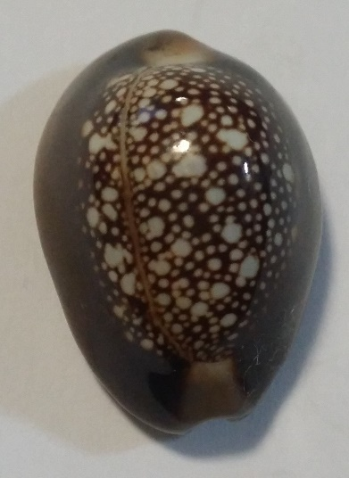
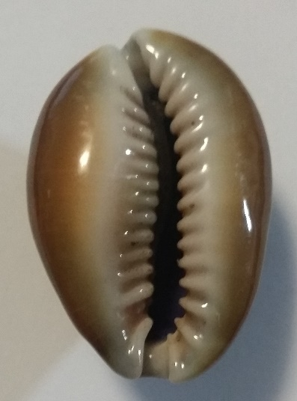
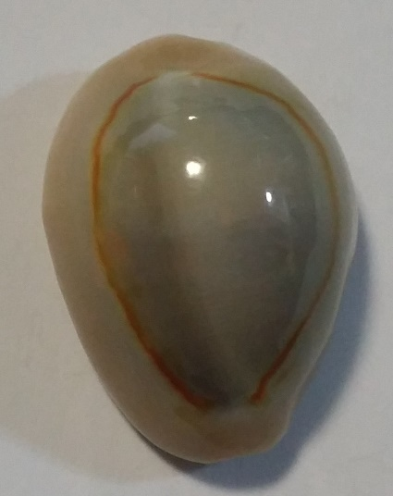
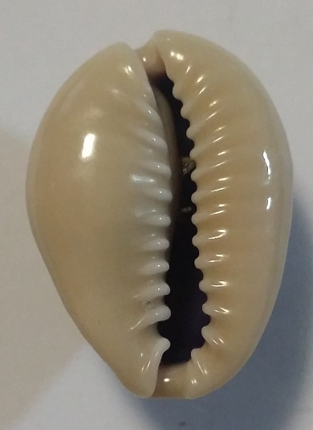
Monetaria
moneta
caputserpentis
annulus
Monetaria moneta, 35.6mm
Kosi Bay, Northern KZN
Monetaria caputserpentis, 30.5mm
KZN
Monetaria annulus, 28.4mm
Tidal pool, Thompsons Bay, KZN

Slide 13
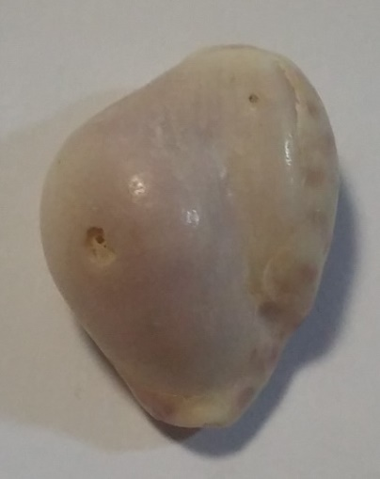
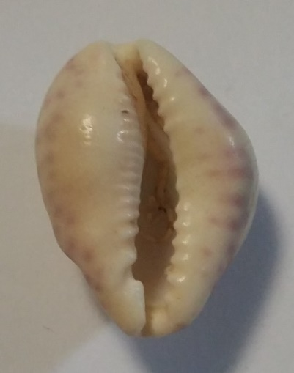
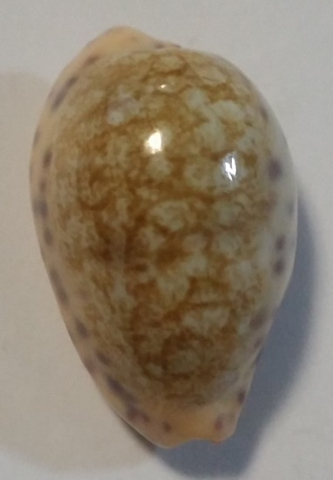
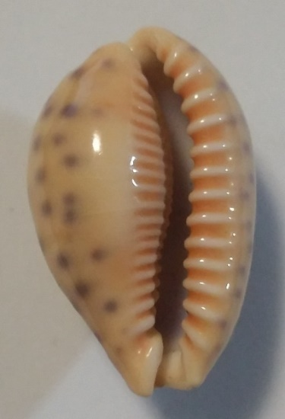
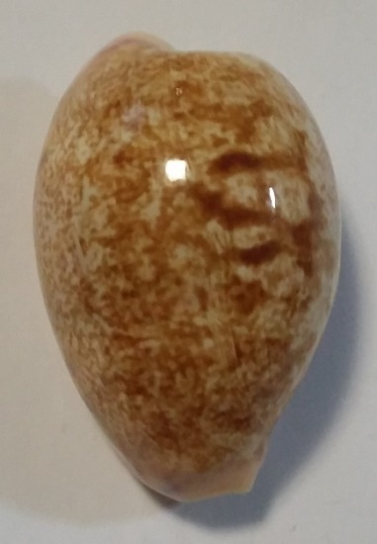
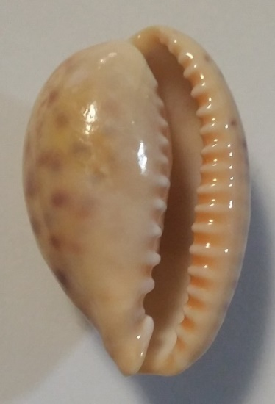
Ovatipsa
chinensis violacea
chinensis variolaria
chinensis tortirostris
Ovatipsa chinensis tortirostris, 28.7mm
Park Rynie, KZN
Ovatipsa chinensis variolaria, 25mm
Dredged 70m, Southern KZN
Ovatipsa chinesis violacea, 38mm
Dived 45m, Umzumbe, KZN

Slide 14
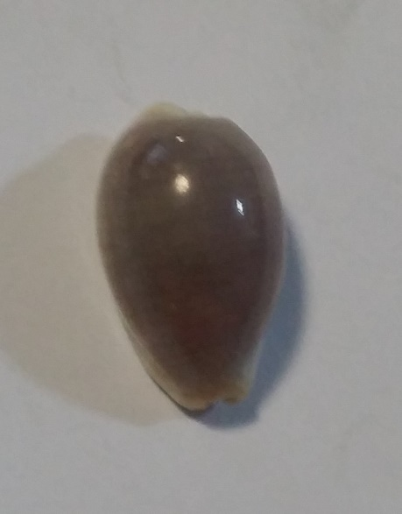
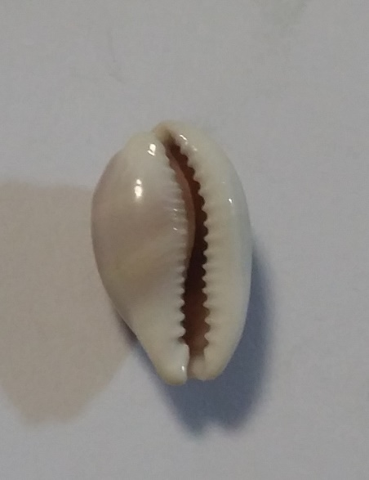
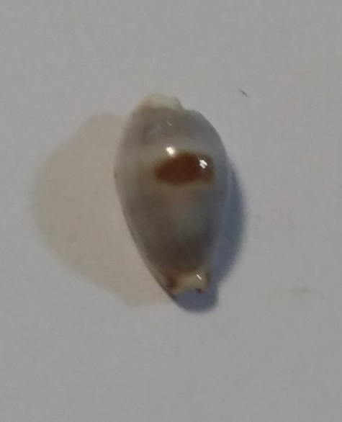
Palmadusta
clandestina
contaminata distans
ziczac
Palmadusta clandestina passerina, 17.1mm
Dived, Hibberdene, KZN
Palmadusta contaminata distans, 10.6mm
Dredged 40m, KZN

Slide 15
Purpuradusta
fimbriata durbanensis
Purpuradusta fimbriata durbanensis, 15mm
Ex Pisce, 800ft, Richards Bay, KZN

Slide 16
Staphylaea
nolani
Staphylaea staphylaea nolani, 14.4mm
Under rocks, Park Rynie
* endemic

Slide 17
Talostolida
teres
teres natalensis
Talostolida teres teres, 26.8mm
Jeffreys Bay, EC
Talostolida teres natalensis, 33.1mm
Ex Pisce 100m, Port Edward, KZN
* endemic

Slide 18
Talparia
talpa
Talparia talpa, 46.4mm
Dived 28m, Durban, KZN

Slide 19
Some locals are quite rare…
These include:
Afrozoila fultoni fultoni (GB Sowerby III, 1903)
Lyncina broderipii (Gray in GB Sowerby I, 1832)
Ficadusta barclayi (Reeve, 1857)
* endemic

Slide 20
But –
- one Taxon is missing from the aforementioned lists.
It is…..

Slide 21
Leporicypraea
Map Cowries

Slide 22
Let the Confusion Begin
This is where it all gets very confusing.
Based on work by Marco Passamonti and Mirco Bergonzoni
Beautiful Cowries Magazine no 6, Dec 2014
118 pages, 40 pages text, 78 colour plates
Taxonomy changes rapidly
Splitting
New sub-genera (+ new sub-species)
Felix Lorenz and Randy Bridges

Slide 23
Maps of the World
Genus: Leporicypraea Iredale, 1930
Central Indian Ocean
L mappa alga f. geographica
East Indian Ocean
L mappa alga f. geographica
Western Pacific Ocean, Philippines
L mappa alga f. geographica
L mappa mappa
Pacific Ocean – Melanesia
L mappa mappa (incl f. panerythra)
L mappa viridis (incl f. guamensis and f. montrouzieri + f. kanakinus – NC)
L mappa rewa
Pacific Ocean – Micronesia
L mappa viridis f. eluceta
Pacific Ocean – Polynesia
L mappa rewa
L mappa admirabilis
alga f. geographica
mappa
mappa f. panerythra
viridis
viridis f. guamensis
viridis f. montrouzieri
viridis f. kanakinus
Viridis f. eluceta
rewa
admirabilis
…does not include the East African species…

Slide 24
Maps of East Africa
Of greater interest to SA collectors.
4 subspecies:
Passamonti & Bergonzoni | Lorenz et al | General Region
L mappa alga (Perry, 1811) | L mappa geographica (Schilder & Schilder, 1933) | S. Mozambique – N. Red Sea + Seychelles + Madagascar + Mascarenes
L rosea ultraviola Lorenz & Bridges, 2014 | L mappa ultraviola Lorenz & Bridges, 2014 | S. Mozambique – Kenya + Madagascar + Seychelles
 | L rosea singularis Lorenz, 2016 | Red Sea
L rosea rosea (Gray, 1824) | L rosea subsignata (Melville, 1888) | Mascarenes (Mauritius, Saint Brandon, Rodriguez)
L rosea aliwalensis Lorenz, 2002 | L aliwalensis Lorenz & Hubert, 2000 | KZN, South Africa

Slide 25
Regional Maps: 1
L mappa alga (Perry, 1811)

Slide 26
Regional Maps: 2
L rosea ultraviola Lorenz & Bridges, 2014

Slide 27
Regional Maps: 3
L rosea rosea (Gray, 1824)

Slide 28
Regional Maps: 4
L rosea aliwalensis Lorenz, 2002

Slide 29
Let’s Compare…
L mappa alga:
Rhomboidal to ovate
Dense, irregular dorsal pattern
Cream base
No basal blotch
Bright orange teeth
Large lateral spots
L rosea ultraviola:
Slender, cylindrical
Irregular, double dorsal pattern
Grey-brown base
Brown/purple-brown basal blotch
Morph 1: brownish // Morph 2: violet
Bright orange teeth
Fine, dense lateral spots
L rosea rosea:
Slender but more ovate
Irregular, dark brown double dorsal pattern
Whitish base
Large purple basal blotch
Bright orange teeth
Fine, dense lateral spots
L rosea aliwalensis:
Slender, sub-cylindrical
Irregular, reticulate dorsal pattern
Brownish base
Brownish basal blotch, often faint
Bright orange teeth
Fine, dense lateral spots

Slide 30
To Summarise:
Maps of the World
* excludes forms e.g. panerythra

Slide 31
Of greatest interest to us…
… is Leporicypraea rosea aliwalensis.
This is a true South African cowrie.
Southernmost mappa species.
Southern limit is Pumula.
Northern limit is Ponta Techobanine (just south of Maputo).
Depth range: 20 to 55m average / 4m on Aliwal Shoal.
Heavily predated by mussel cracker and natal wrasse.
Always in hiding in crevices, under rocks or in large sponges.
Found alongside L mappa alga (southern limit = Sodwana Bay = vary rare in SA).
A sought-after shell by collectors.

Slide 32
Colour Plate 1
rosea aliwalensis

Slide 33
Colour Plate 2
rosea aliwalensis

Slide 34
A live specimen:
rosea aliwalensis

Slide 35
Show ‘n Tell…

