Slide 1
Harpago
Spiny Tropical Giants

Slide 2
Where it Began
Collect Strombidae exclusively
Confusion in Nomenclature (genera, species, subspecies, forms/variations, synonyms)
Study Team (June – Nov 2012; Winston Barney, Guido & Philippe Poppe, Eddie Hardy, Ulrich Wieneke, Han Stoutjesdijk, Philippe Simonet, Dennis Sargent, Gijs Kronenberg)
Study individual Genera
Harpago (American Conchologist Vol 41 No 4, Dec 2013)
Thersistrombus (American Conchologist Vol 42 No 3, Sep 2014)

Slide 3
Today’s Talk
Nomenclature
Morphology
Size Variation
Habitat
Location
Additional Examples
Why Collect?

Slide 4
Nomenclature
Stromboidea
Rafinesque, 1815
Strombidae
Rafinesque, 1815
Superfamily
Family
Genus
Harpago
Mörch, 1852
Harpago arthriticus (Röding, 1798)
Species
Harpago chiragra (Linnaeus, 1758)
Harpago rugosus (Sowerby, 1842)

Slide 5
Nomenclature: TS
Type Species
Original naming: | Lambis harpago Röding, 1798
Accepted as: | Harpago chiragra (Röding, 1798)
Harpago arthriticus (Röding, 1798) | Synonyms
 | Harpago arthritica (Röding, 1798)
 | Lambis arthritica Röding, 1798
 | Lambis chiragra arthritica (Röding, 1798)
 | Lambis chiragra f. arthritica (Röding, 1798)
 | Strombus divergens Perry, 1811
 | Strombus nigricans Perry, 1811

Slide 6
Nomenclature
Harpago chiragra (Linnaeus, 1758) | Synonyms
 | Strombus chiragra Linnaeus, 1758
 | Lambis chiragra (Linnaeus, 1758)
 | Lambis harpago Röding, 1798
 | Lambis undulata Röding, 1798
 | Pterocera kochii Freyer, 1855
Harpago rugosus (G.B. Sowerby II, 1842) | Synonyms
 | Harpago rugosa (Sowerby, 1842)
 | Pterocera rugosa Sowerby, 1842
 | Lambis rugosa Sowerby, 1842
 | Lambis chiragra f. rugosa (Röding, 1798)
Male form of chiragra

Slide 7
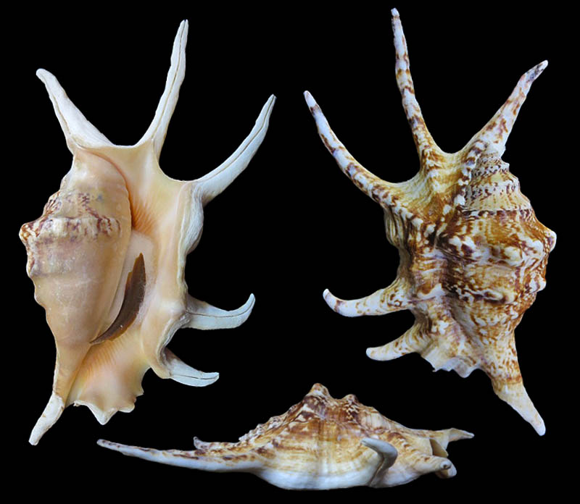
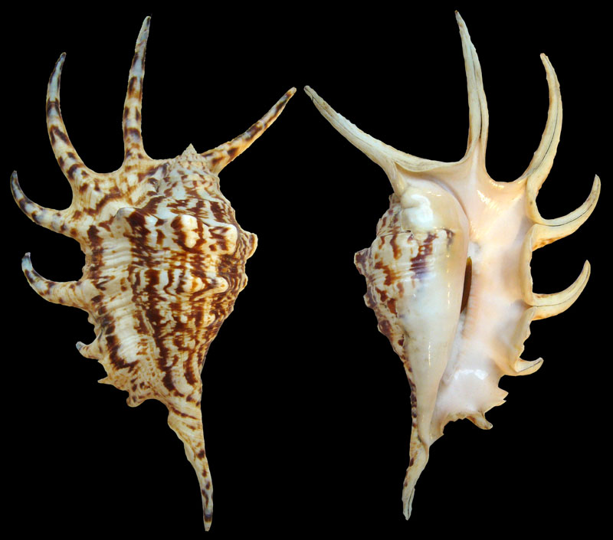
Nomenclature: hybrids
Exceptionally rare hybrid: | H. chiragra X Lambis lambis
Coll Hitoshi Ikeda | Coll Alain Allary
Images courtesy Stromboidea.de

Slide 8
Morphology
Instead of Descriptions – Graphical ID Plates
Main features
Help to easily distinguish between species visually

Slide 9
Morphology – Aperture

Slide 10
Morphology – Aperture Detail

Slide 11
Morphology - Dorsal

Slide 12
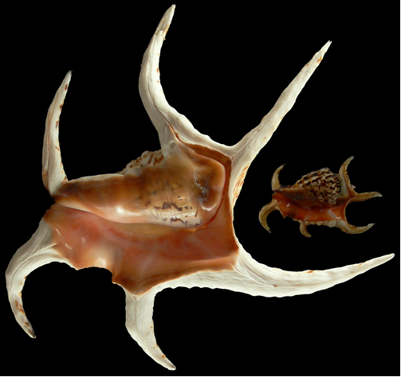
Size Variation
Species | Basic Variation |  | Current WRS
Harpago arthriticus | 110 – 190mm |  | 178.5mm, Tanzania
Harpago chiragra | 85 – 260mm |  | 343.5mm, W Australia
Harpago rugosus | 120 – 170mm |  | 186.5mm, N Caledonia
305mm (Exmouth Gulf, WA) |  | 98mm (Olango Is, Philippines)
Harpago chiragra

Slide 13
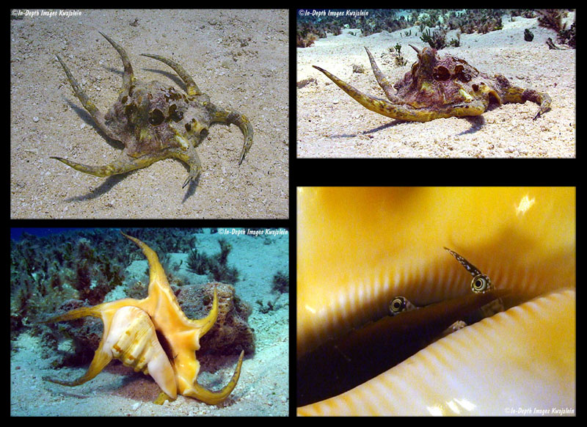
Habitat
Characteristic | Detail
Herbivores (mollusc) | Algae; marine plant life
Shallow depths | 1 – 3m
Varied terrain | Flat reefs Sand between coral/rocks Tide pools Algal reefs Stony reefs Among coral rubble
Tropical/sub-tropical waters, flat reefs, sandy flats, near marine plant life
Image courtesy Scott Johnson, Kwajalein Atoll

Slide 14
Location
Harpago arthriticus
Western Indian Ocean / African Coast
Central Indian Ocean / African Islands
Northern Indian Ocean / India
Eastern Indian Ocean / Thailand – Indonesia
Philippines
Harpago rugosus
Coral Sea / SE Australia – NC
Central Pacific / French Polynesia

Slide 15
Location
Harpago chiragra
Western Indian Ocean / Madagascar
Northern Indian Ocean / India (black-mouth)
Eastern Indian Ocean / Thailand – Indonesia
South China Sea
Philippines
Western Pacific (except H. rugosus)
Philippine Sea / Guam
Central Pacific / Marshall Islands

Slide 16
Location

Slide 17
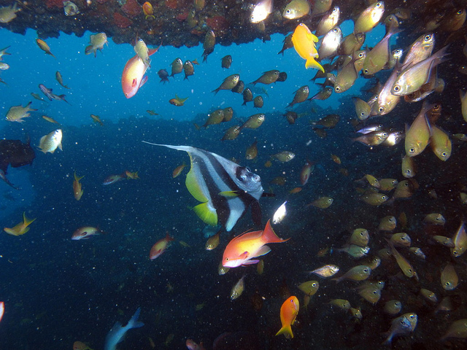
Location
Harpago in SA:
H. arthriticus
KZN Coast (reefs)
Rare in SA waters

Slide 18
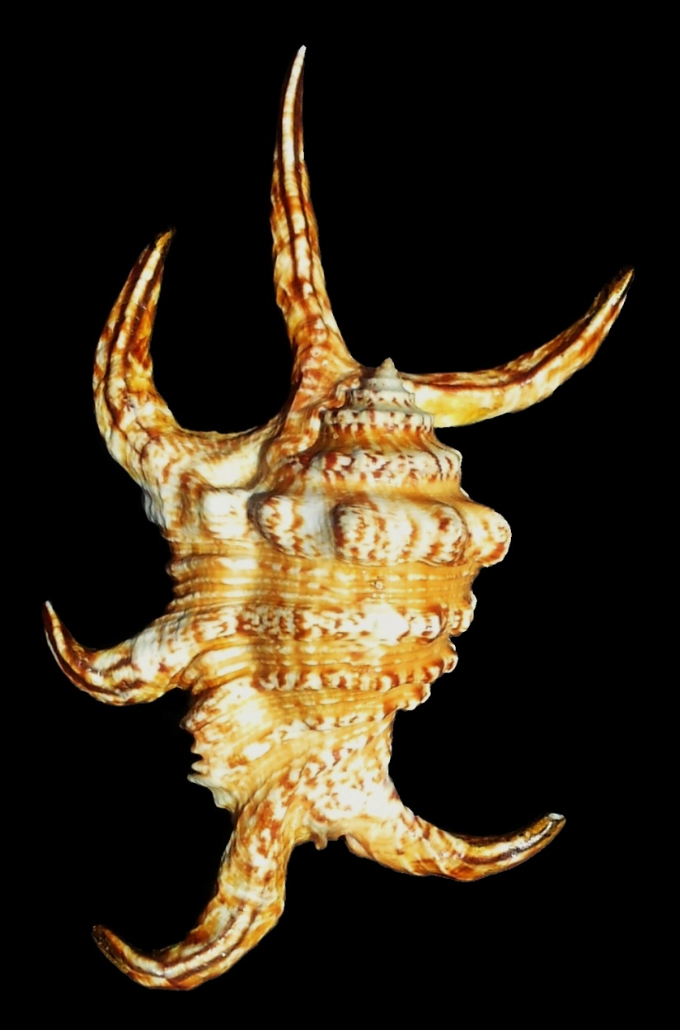
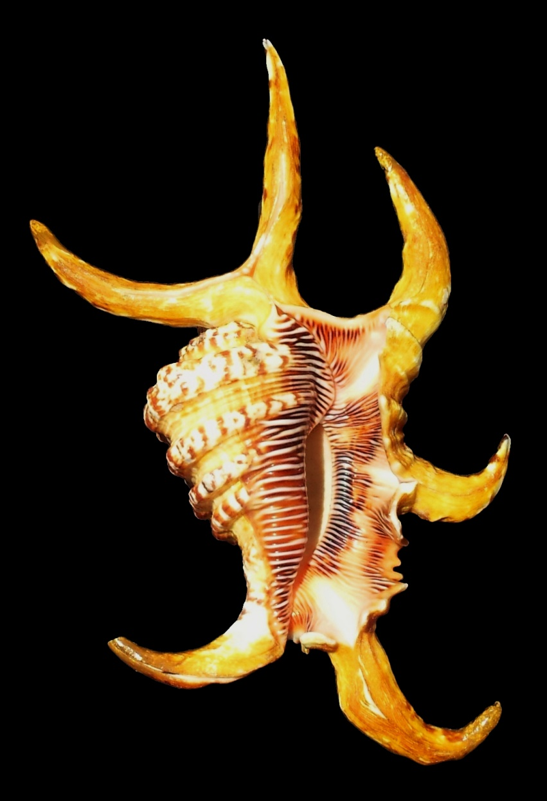
Additional Examples – H. arthriticus
143mm, Zanzibar Island, Tanzania

Slide 19
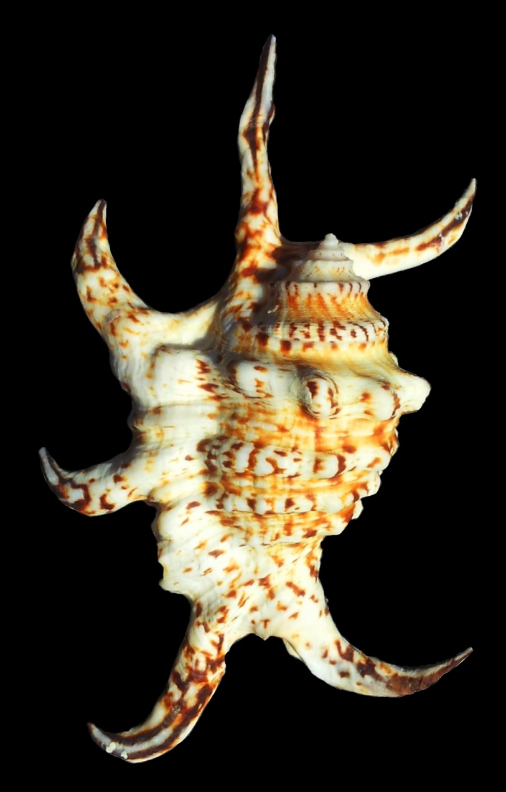
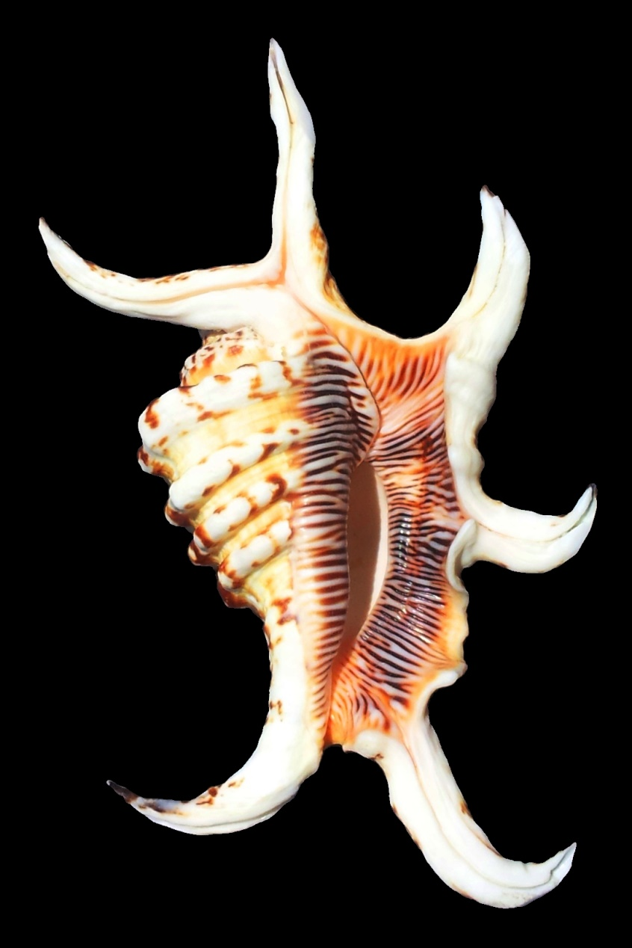
Additional Examples – H. arthriticus
107.5mm (dwarf), NW Mauritius

Slide 20
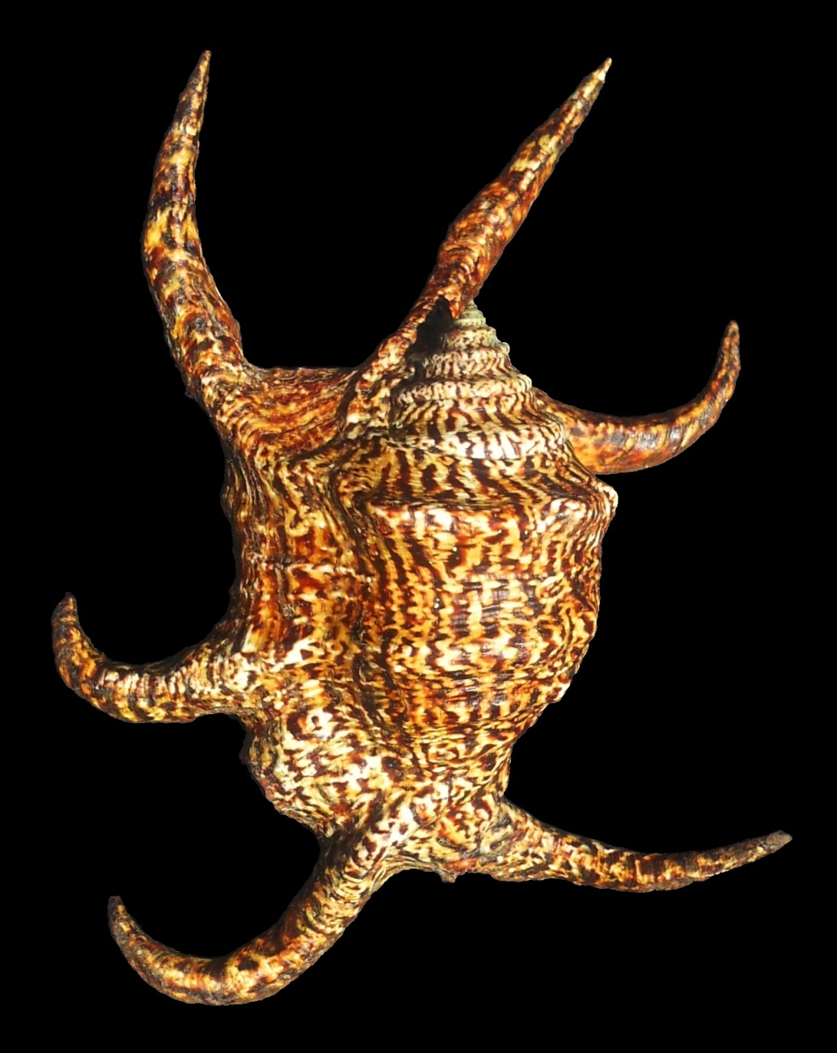
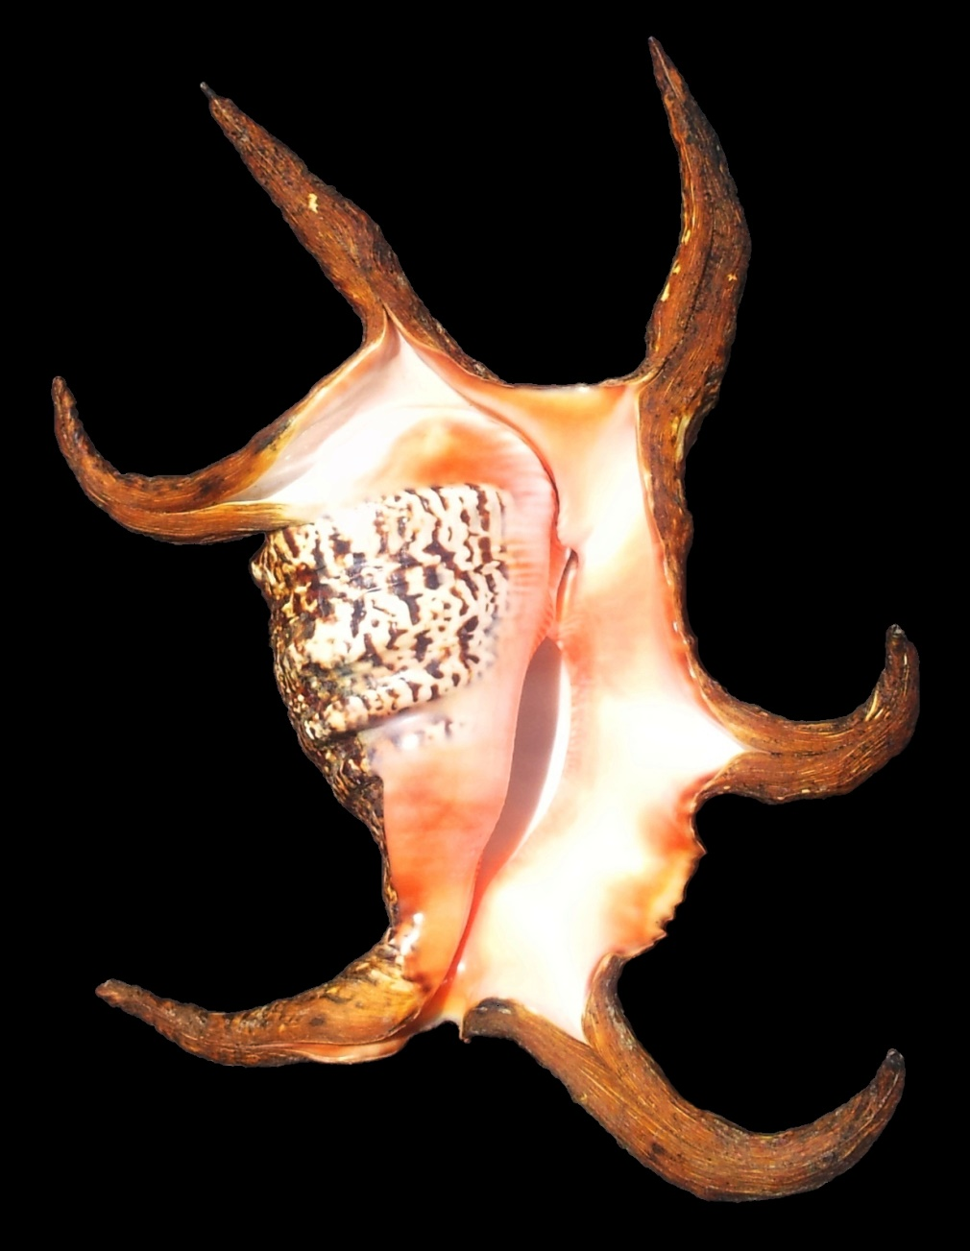
Additional Examples – H. chiragra
256mm, Balabac Island, Philippines (with perio)

Slide 21
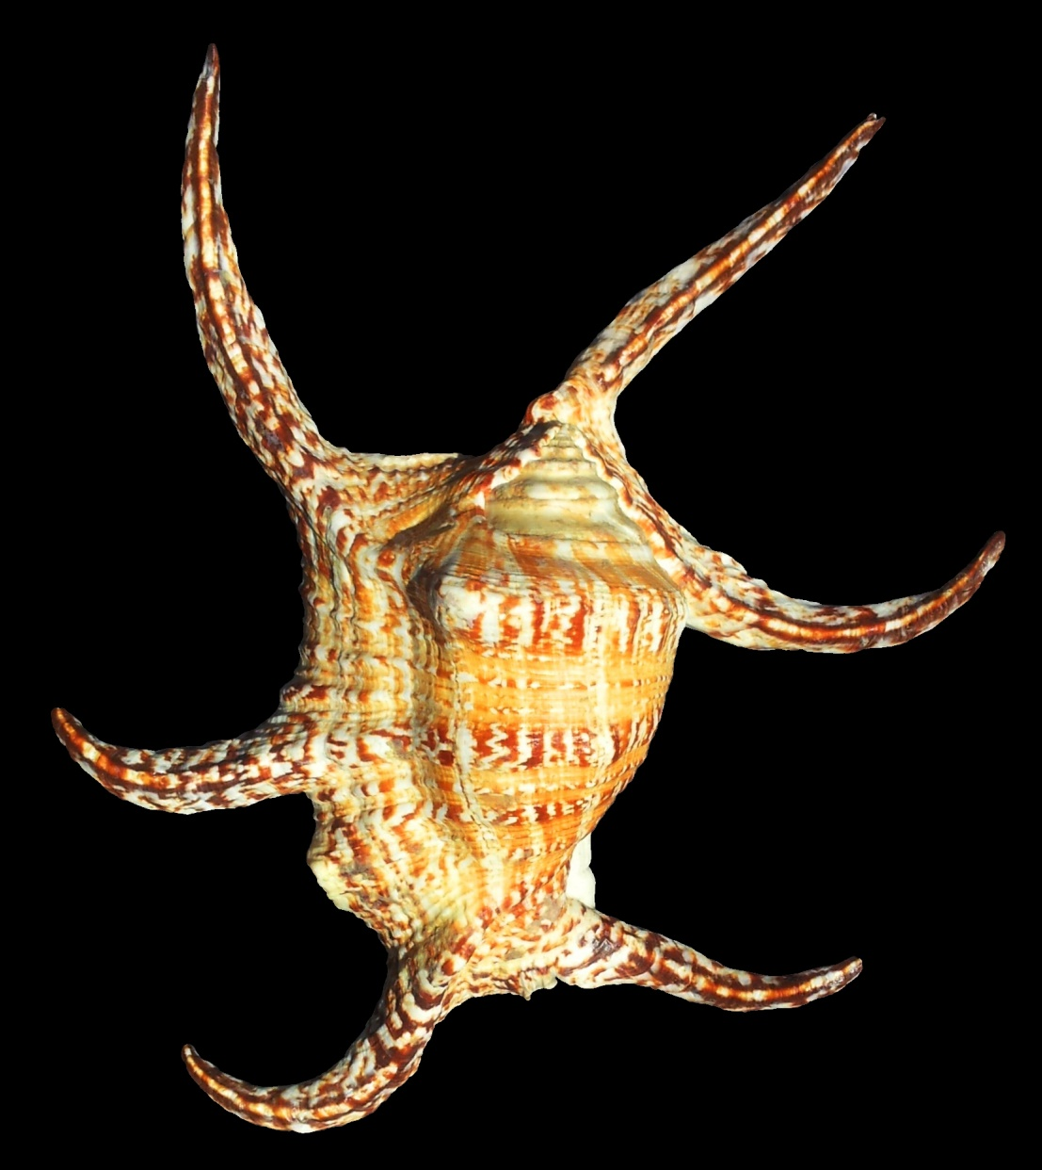
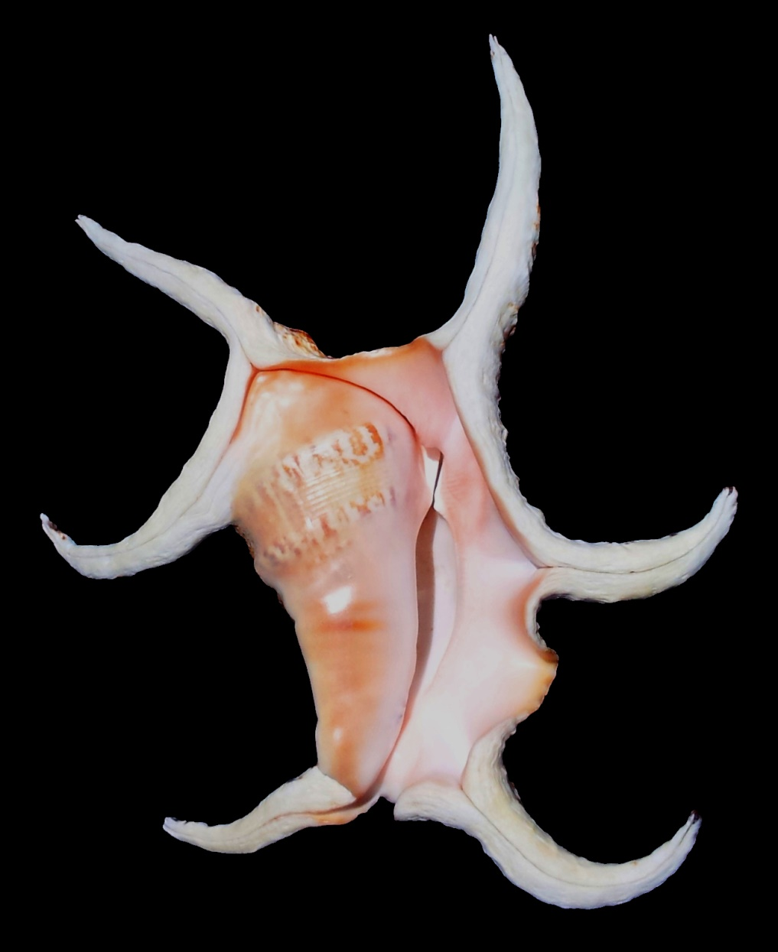
Additional Examples – H. chiragra
305mm (giant), Diego Suarez, Madagascar

Slide 22
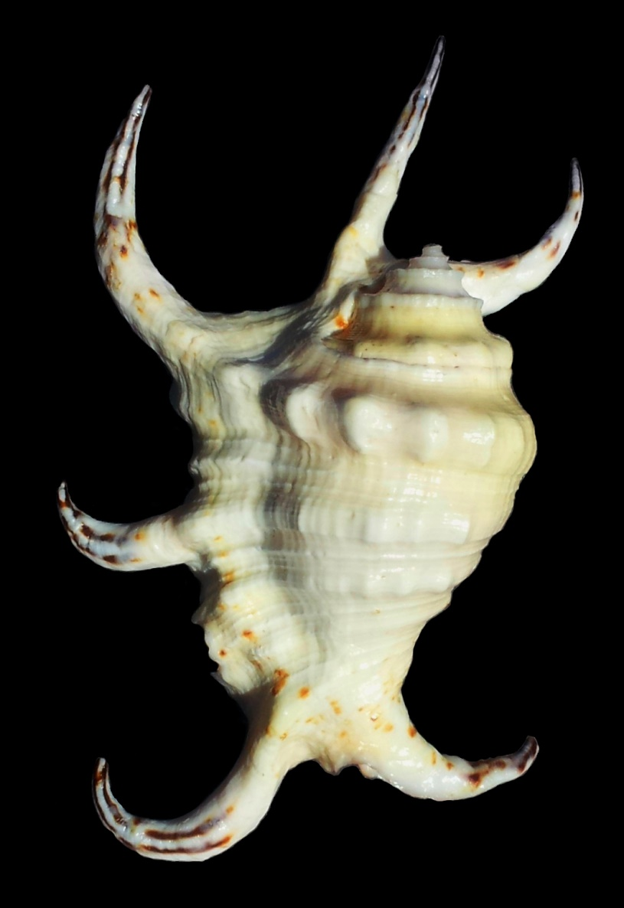
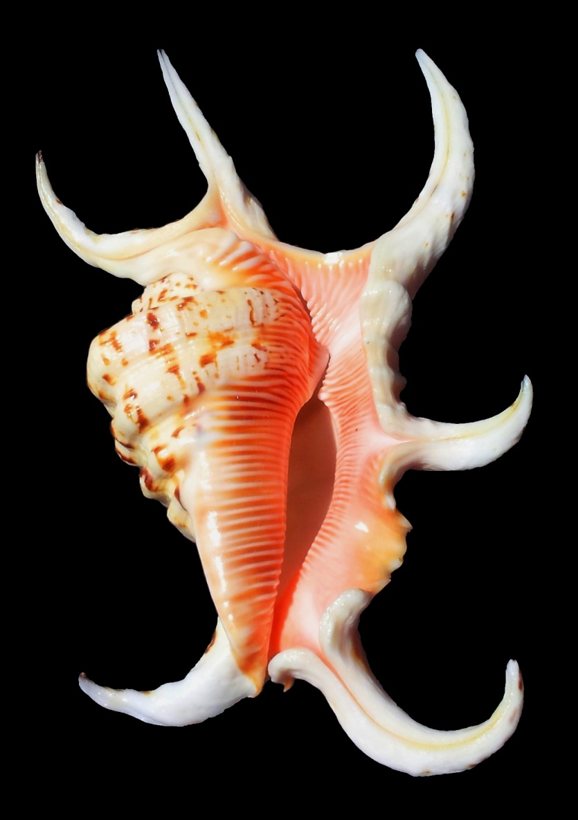
Additional Examples – H. chiragra
111.7mm (albinistic dwarf), Palawan, Philippines

Slide 23
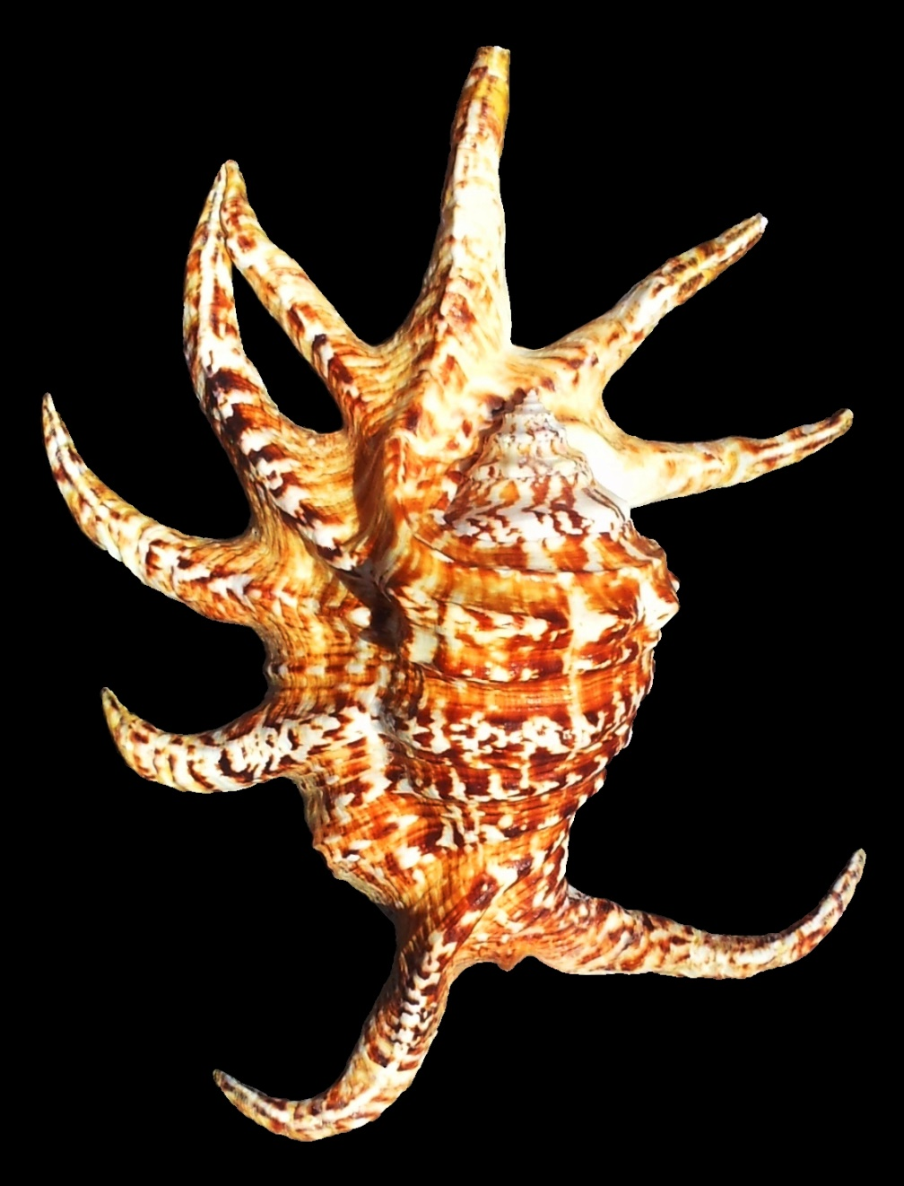
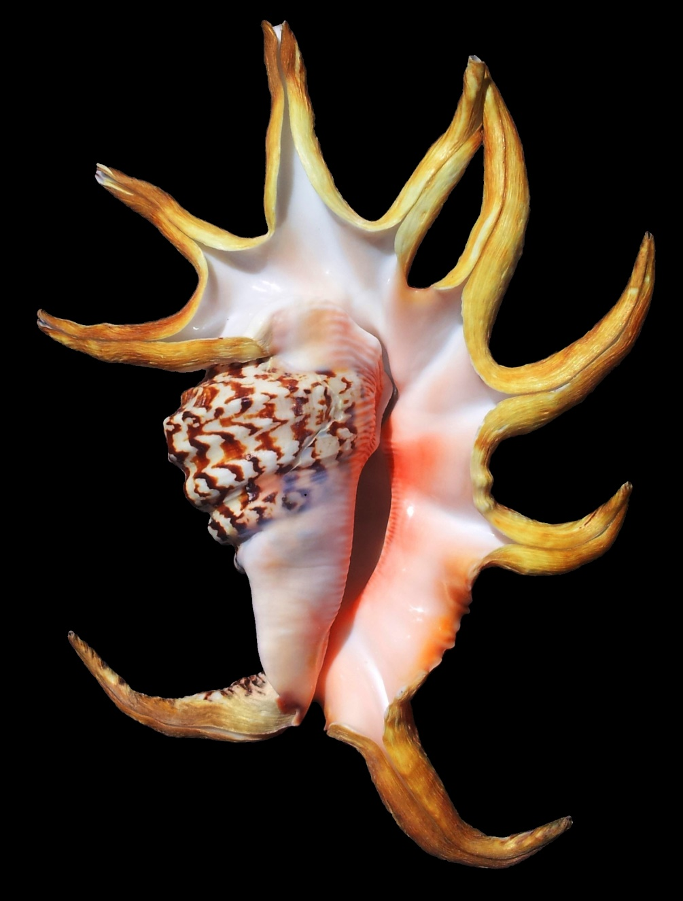
Additional Examples – H. chiragra
230mm, 9-digit aberration – Balesin Island, Philippines

Slide 24
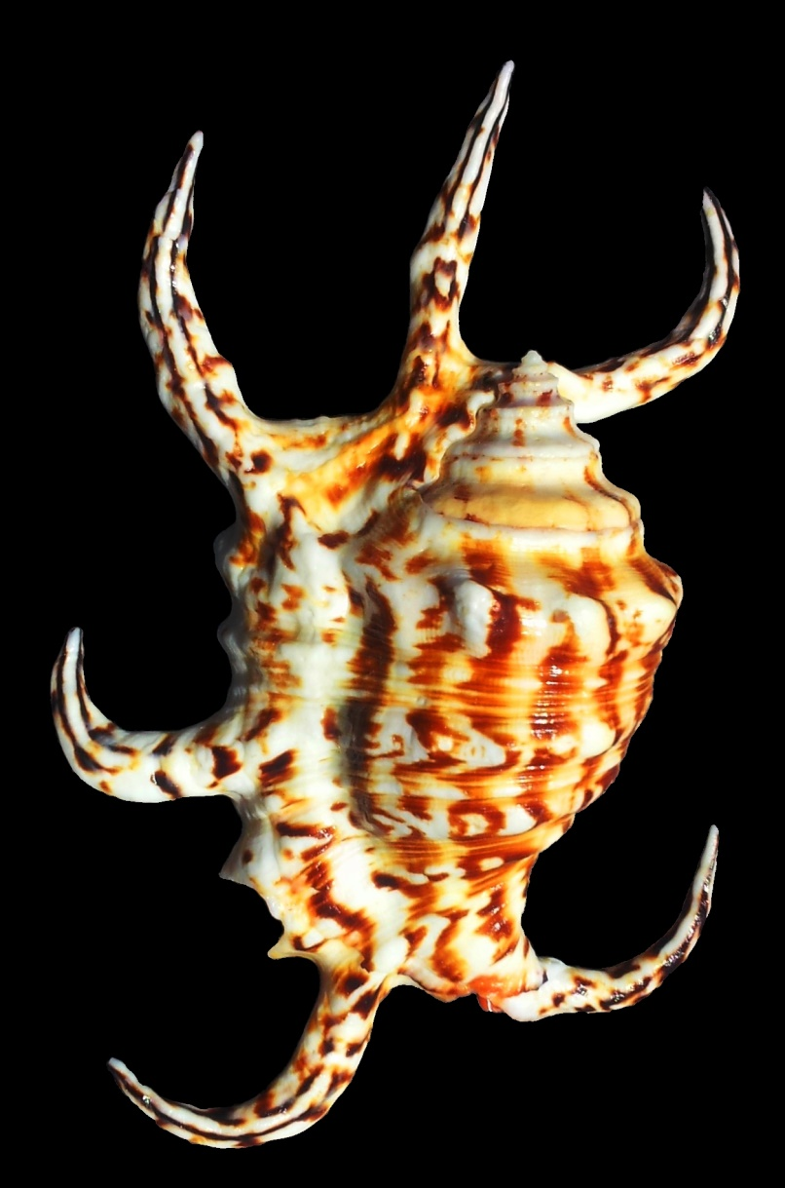
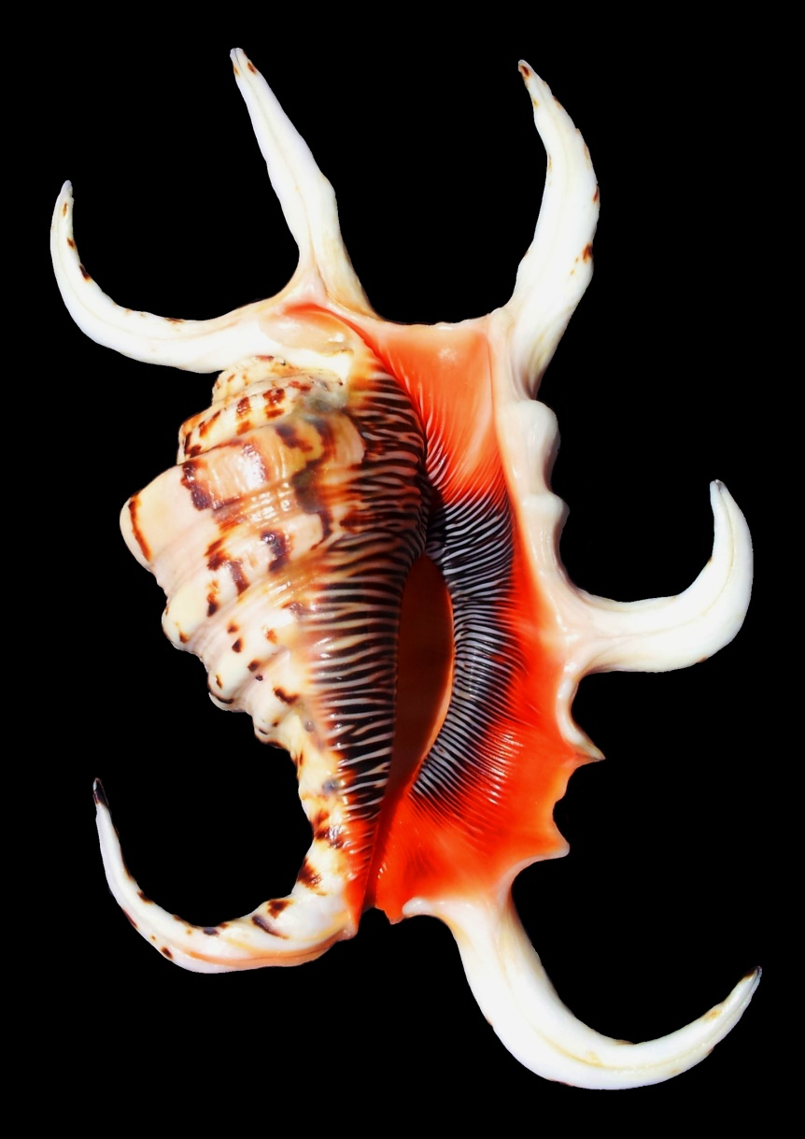
Additional Examples – H. rugosus
155mm, Sournois Reef, Nouméa, New Caledonia

Slide 25
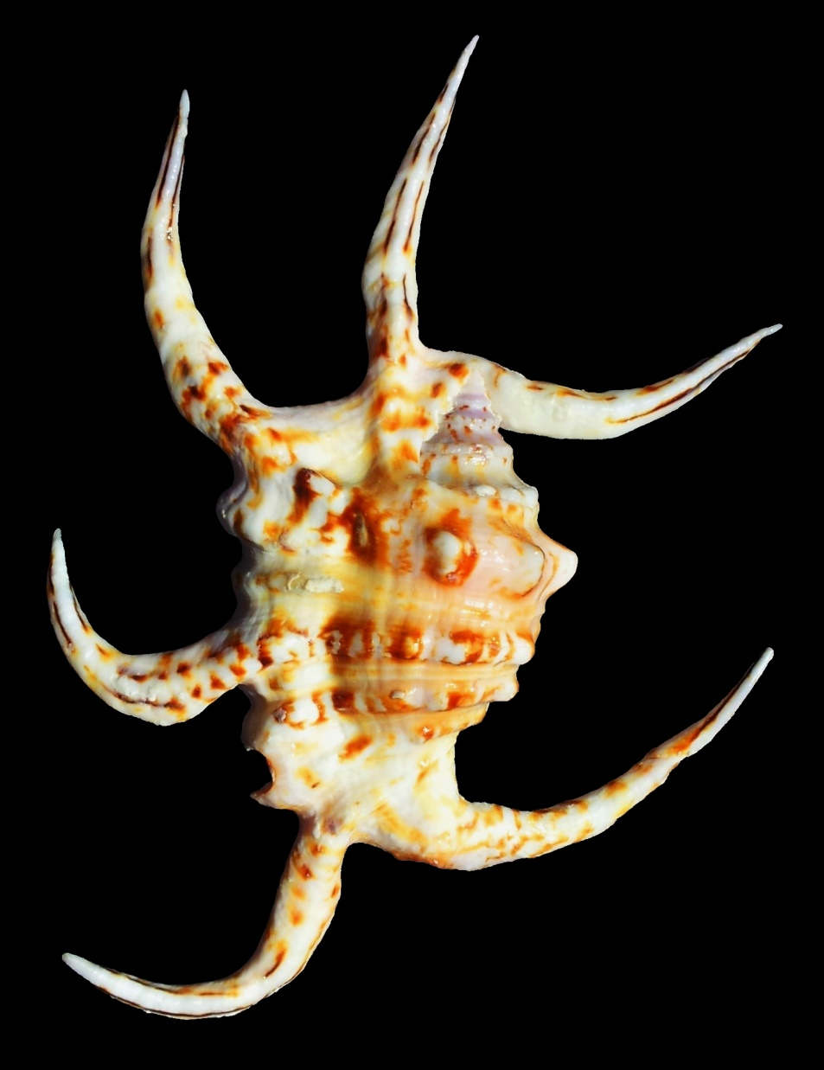
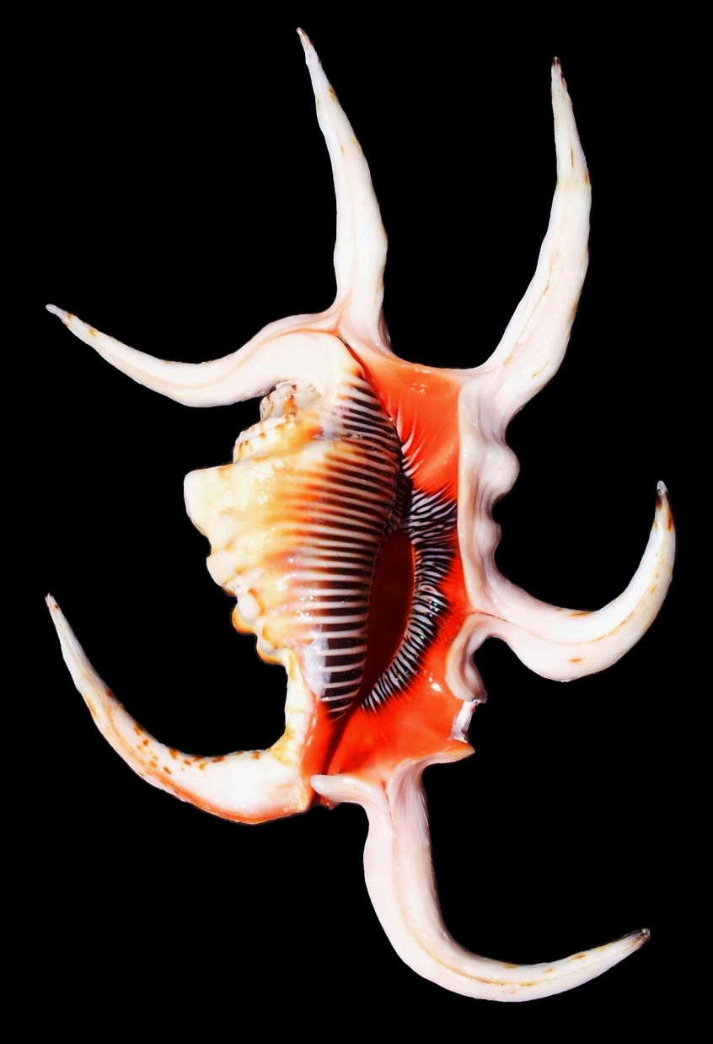
Additional Examples – H. rugosus
149mm, Diamond Islet, Coral Sea, Australia

Slide 26
Why Collect?
Easy to build up huge collection:
Common as hen’s teeth
Cheap
Widely available / offered by dealers, except
Hybrids
Harpago rugosus
Lovely variety in sizes, colours, patterns, shapes – even some lovely freak shells
Make lovely display shells / centrepieces

