Slide 1
Lovely Leggy Lambis
… a pictorial overview

Slide 2
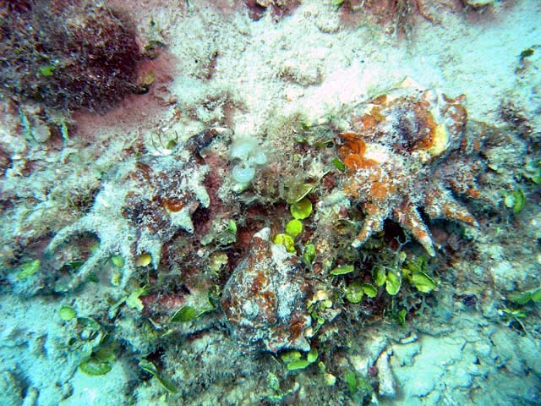
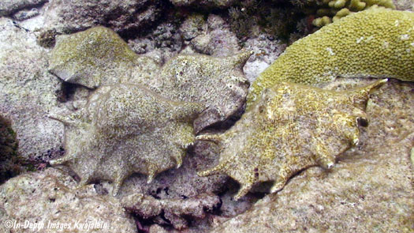
Pretoria Shell Club
By Andre Meredith
9 September 2019
Try to find the shells…

Slide 3
Topic Content
All the “spider-conchs”
Three Genera within Family STROMBIDAE:
Lambis Röding, 1798
Harpago Mörch, 1852
Ophioglossolambis Dekkers, 2012

Slide 4
Topic Content
Species:
Lambis adamii Bozzetti & Cossignani, 2003
Lambis lambis (Linnaeus, 1758)
Lambis millepeda (Linnaeus, 1758)
Lambis truncata ([Lightfoot], 1786) {3 spp}
Lambis arachnoides Shikama, 1971
Lambis crocata (Link, 1807)
Lambis pilsbryi Abbott, 1961
Lambis scorpius (Linnaeus, 1758) {2 spp}
Lambis robusta (Swainson, 1821)
Lambis lilikae Villar, 2016
Harpago chiragra (Linnaeus, 1758) {2 spp}
Harpago arthriticus (Röding, 1758)
Ophioglossolambis digitata (Perry, 1811)
Ophioglossolambis violacea (Swainson, 1821)

Slide 5
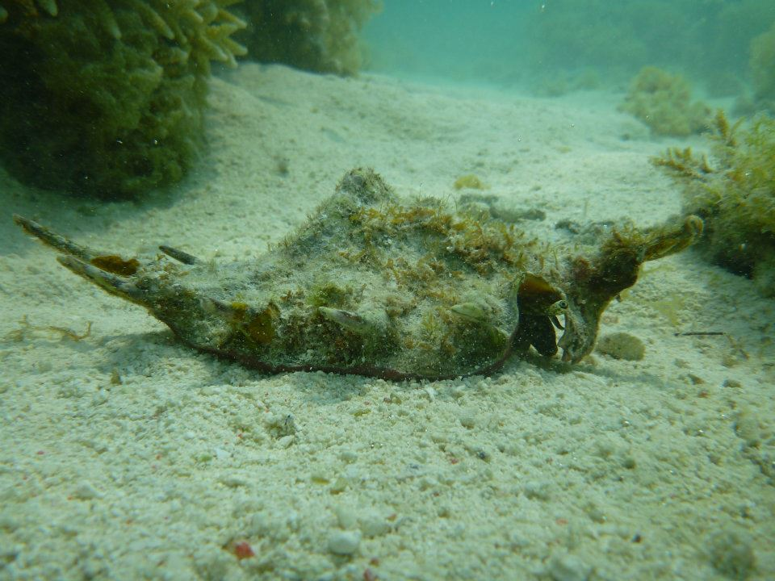
Typical Habitat
Tropical / sub-tropical
Shallow water
Sandy reefs / “grassy” flats
Herbivores
Encrusted dorsal “camouflage”

Slide 6
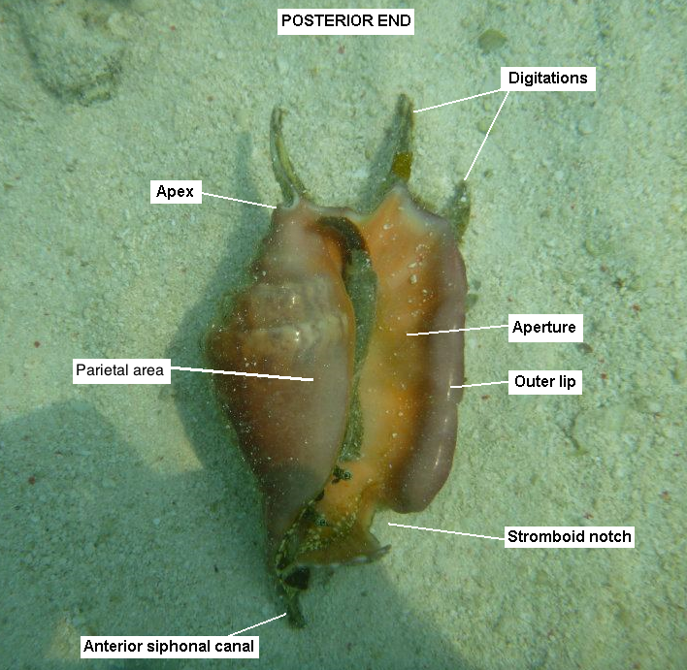
Bits and Pieces
“spider conchs”
Strombidae

Slide 8
Pictorial overview
(1) Distribution maps
(2) Identifying characters

Slide 9
Lambis lambis
“Indo-Pacific” region

Slide 10
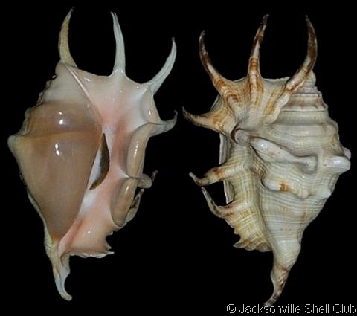
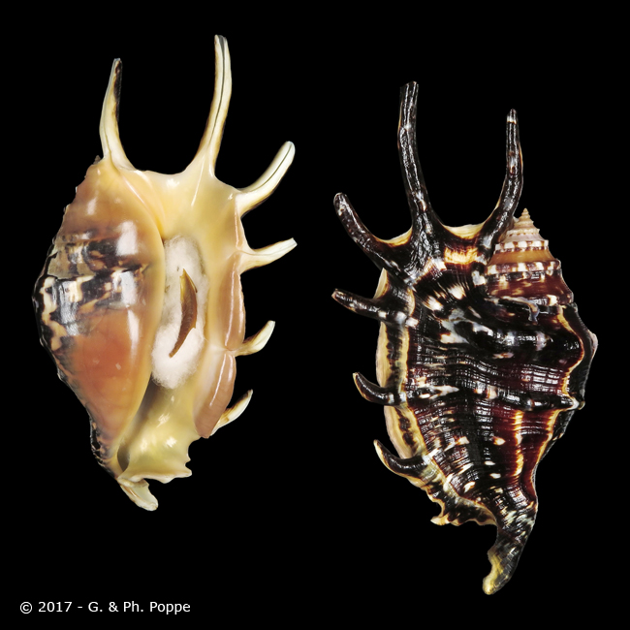
Lambis lambis
Typical specimens
Image © gastropods.com
Image © conchology.be

Slide 11
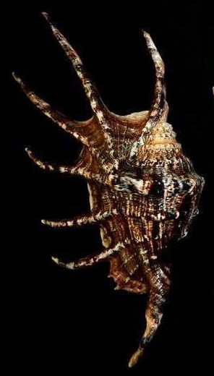
Lambis lambis
Giants from Queensland
Image © Ian Rasmussen

Slide 12
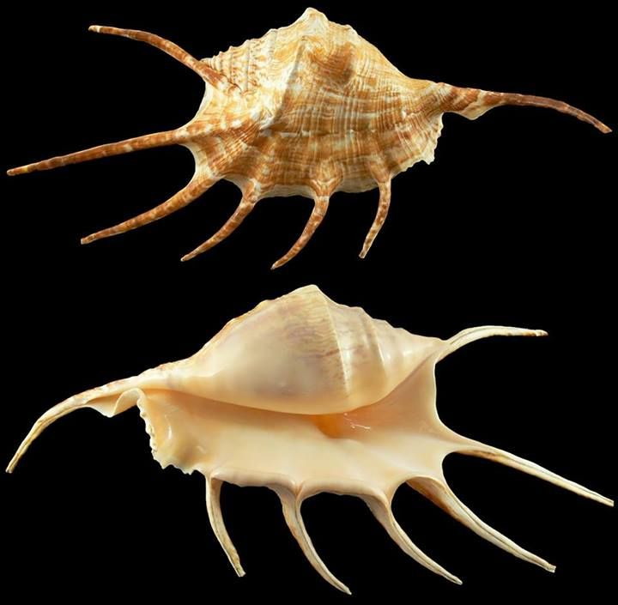
307mm
WRS
Queensland, Australia

Slide 13
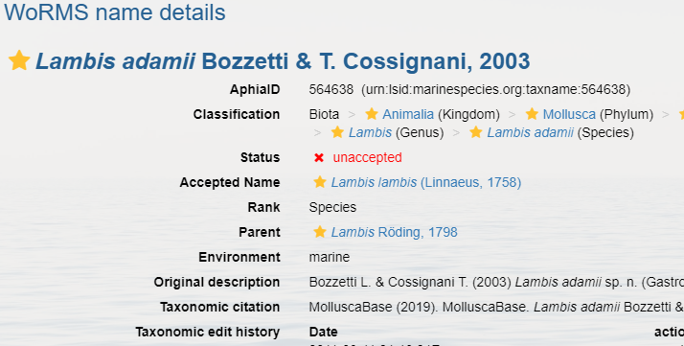
Lambis adamii

Slide 14
Lambis adamii
Southern Philippines

Slide 15
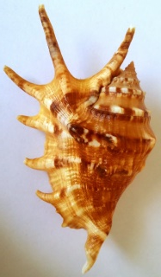
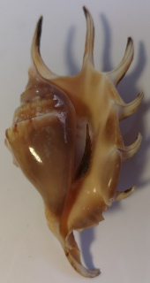
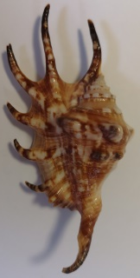
Lambis adamii
Not a juvenile Lambis lambis!
Clear pattern
84mm Lambis adamii
94mm Lambis lambis
Separate species or dwarf form of Lambis lambis?

Slide 16
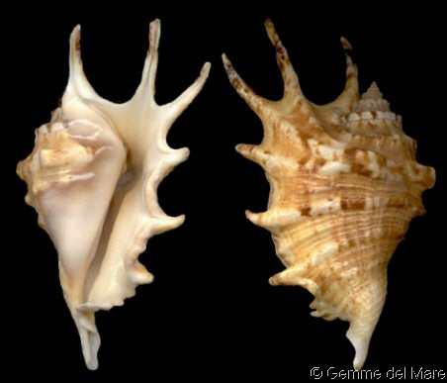
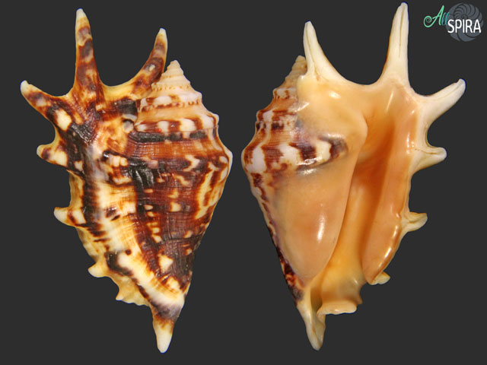
Lambis adamii
Image © gastropods.com
Image © allspira.com

Slide 17
Lambis millepeda
Philippines
Papua New Guinea
Indonesia

Slide 18
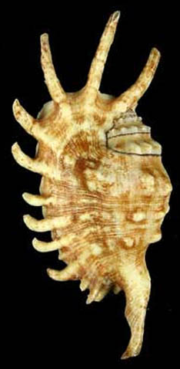
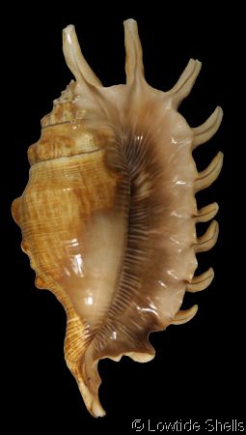
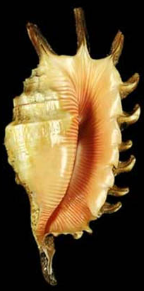
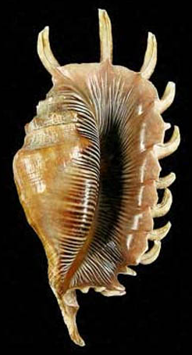
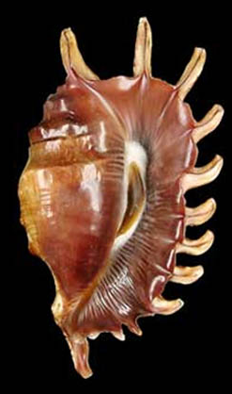
Lambis millepeda
2x Images © stromboidea.de
Image © Lowtide Shells
4x Images © stromboidea.de

Slide 19
Lambis truncata spp.
L. t. sowerbyi
L. t. sebae
“Pacific Ocean truncata”
“Red Sea truncata”
3
L. t. truncata
“Indian Ocean truncata”

Slide 20
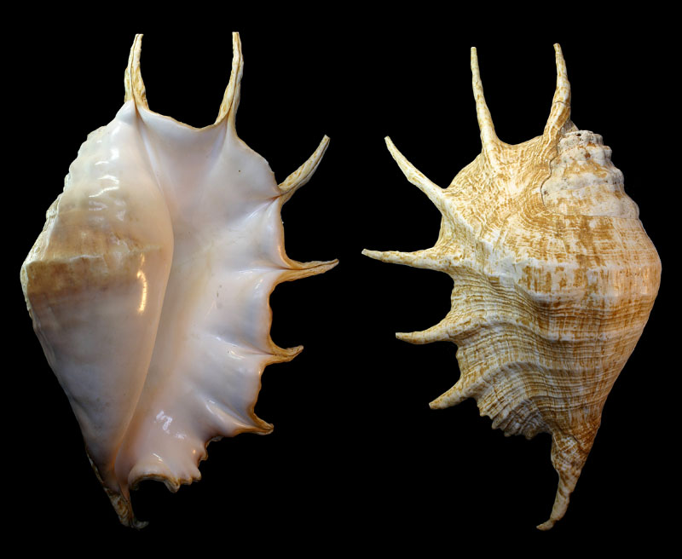
Lambis truncata truncata
truncated
Image © stromboidea.de

Slide 21
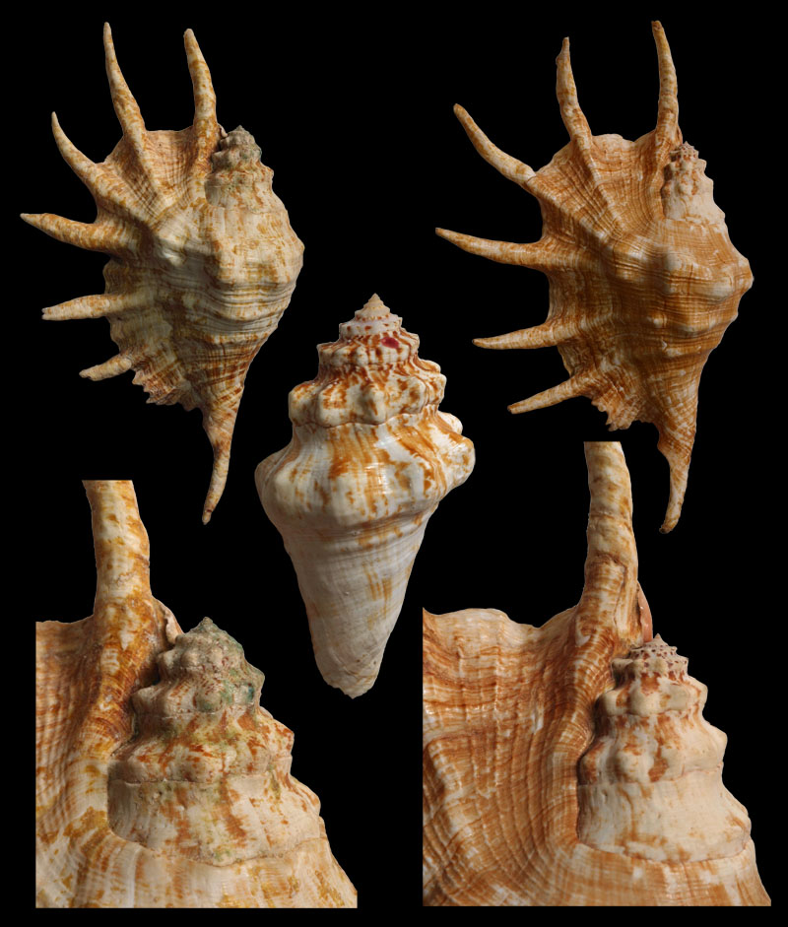
Lambis truncata sebae
Images © stromboidea.de

Slide 22
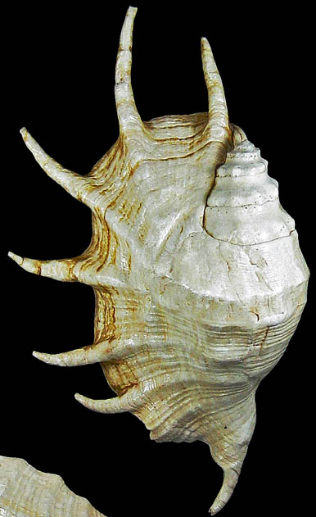
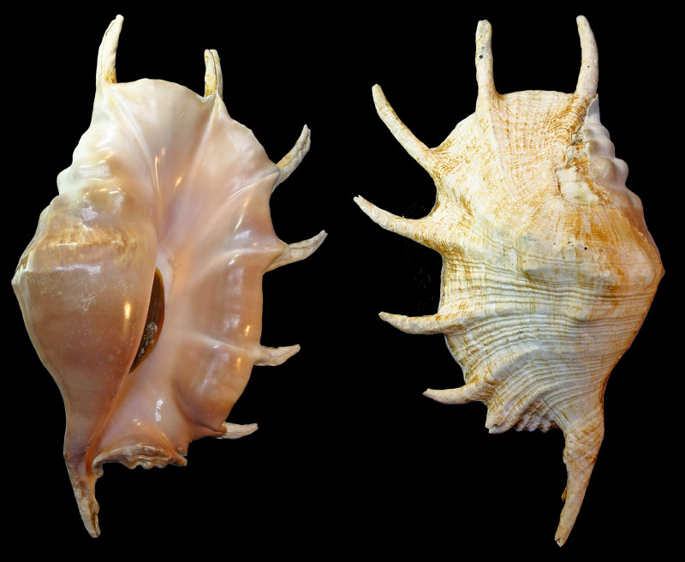
Lambis truncata sowerbyi
?
thicker
Marianas Islands
Images © stromboidea.de

Slide 23
Lambis trunacta sowerbyi
Image © stromboidea.de

Slide 24
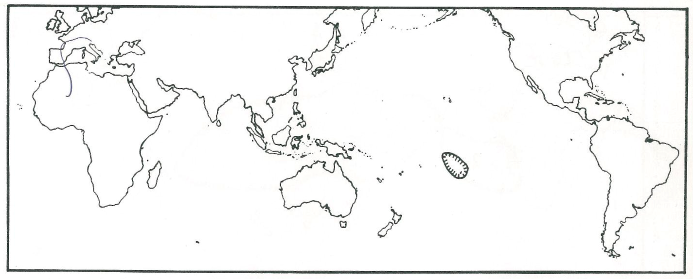
Lambis arachnoides
Overlapping region for:
L. t. sowerbyi
L. millepeda

Slide 25
Lambis arachnoides
millepeda x t. sowerbyi
X

Slide 26
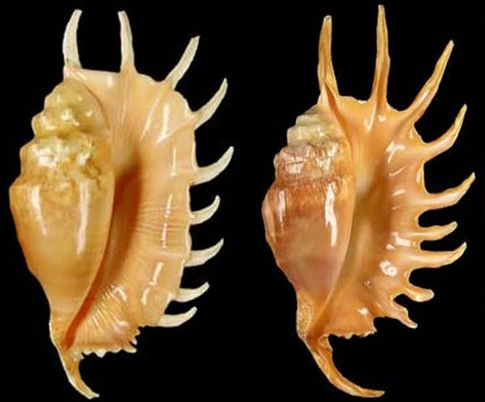
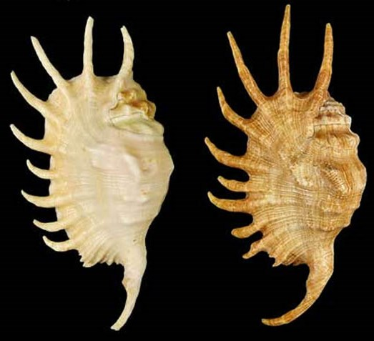
Lambis arachnoides
millepeda
sowerbyi
spire
multiple digits
Common characteristics
lirae
Image © stromboidea.de
longer digits

Slide 27
Lambis crocata spp.
crocata
“Western Pacific Ocean”
crocata
pilsbryi
“Central Indian Ocean”
“Marquesas Islands”
(endemic)

Slide 28
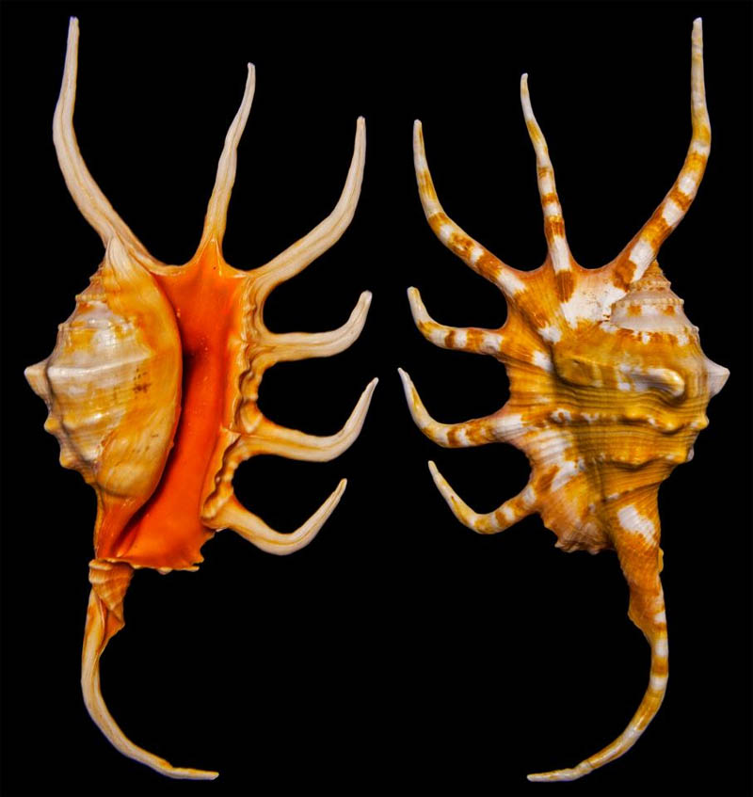
Lambis crocata
Regular crocata
Image © stromboidea.de

Slide 29
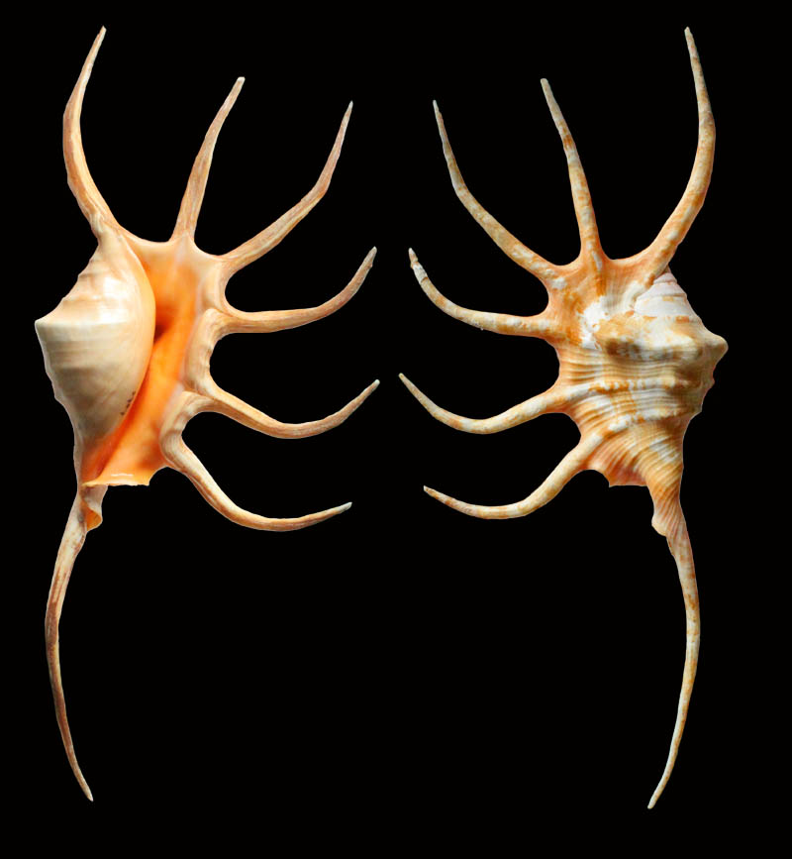
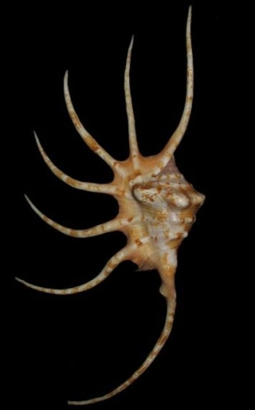
Lambis pilsbryi
… ex Lambis crocata pilsbryi
Image © gastropods.com
Image © stromboidea.de

Slide 30
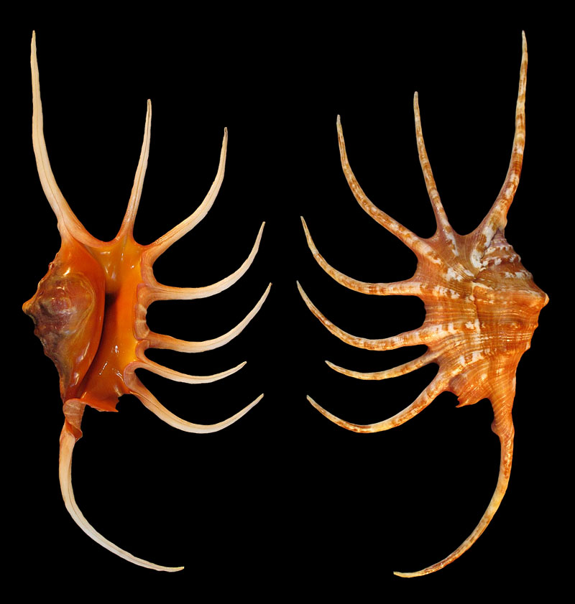
Lambis pilsbryi
Image © Paul Kanner

Slide 31
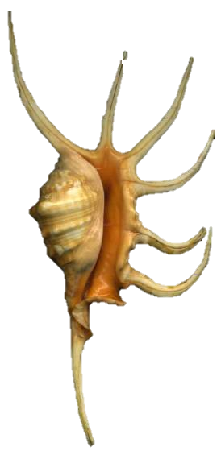
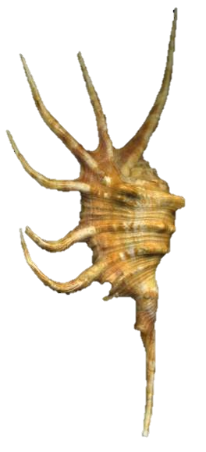
Lambis pilsbryi?
Toliara, Madagascar
Image © Luigi Bozzetti

Slide 32
Lambis scorpius spp.
L. s. scorpius
“Pacific Ocean scorpius”
L. s. indomaris
“Indian Ocean scorpius”

Slide 33
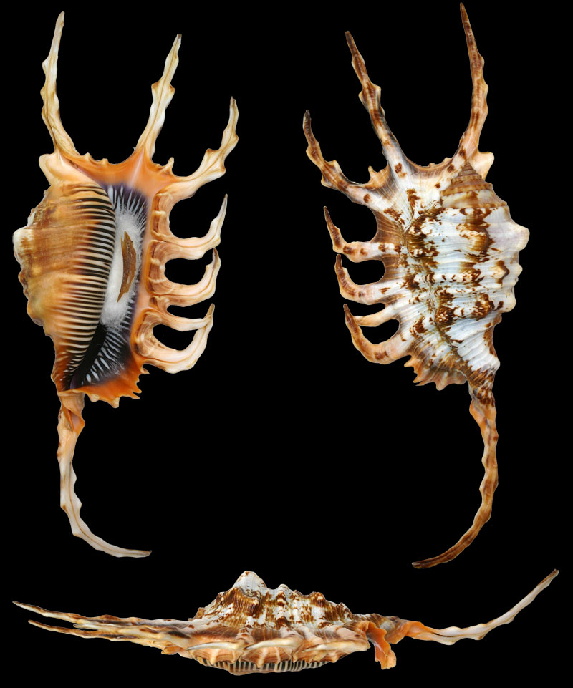
Lambis scorpius scorpius
Image © stromboidea.de

Slide 34
Lambis scorpius scorpius
2x images © allspira.com
Image © gastropods.com
Image © gastropods.com
3x images © conchology.be

Slide 35
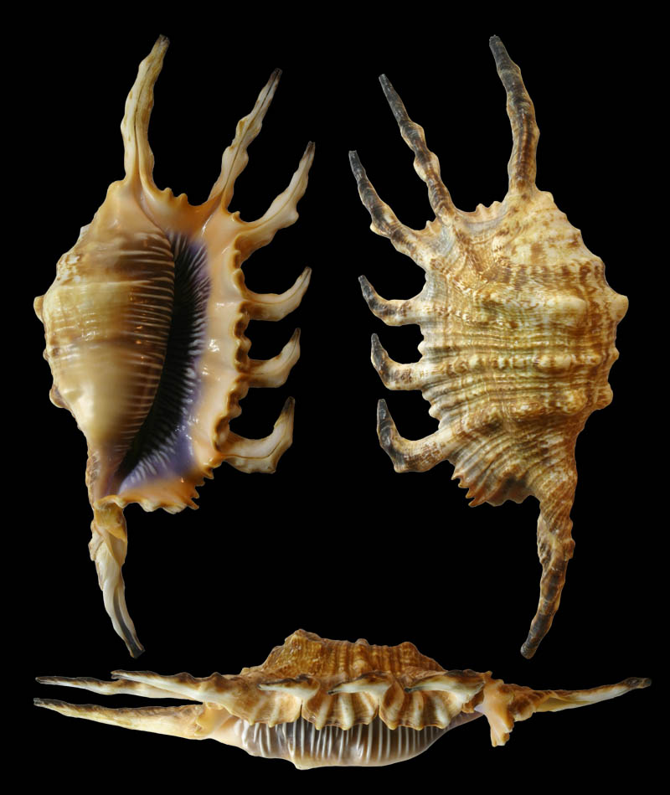
Lambis scorpius indomaris
purple
L. s. scorpius
Image © stromboidea.de

Slide 36
Lambis robusta
“French Polynesia ( Tahiti)”

Slide 37
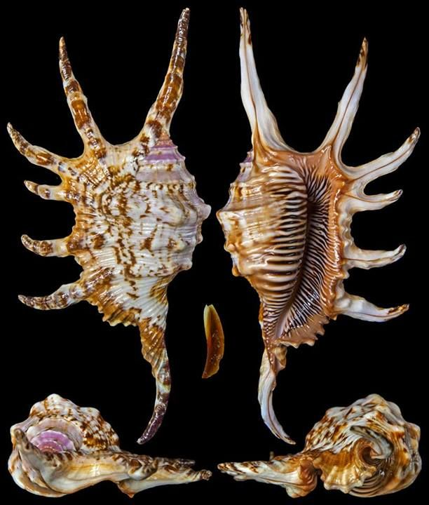
Lambis robusta
thicker digits
digits straight & smooth
L. s. scorpius
Image © stromboidea.de

Slide 38
Lambis lilikae
“Palawan Island, Philippines”

Slide 39
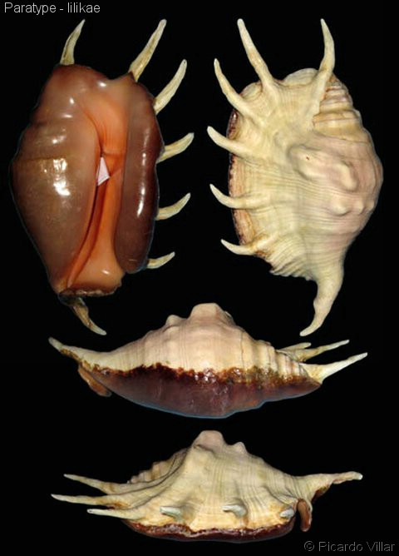
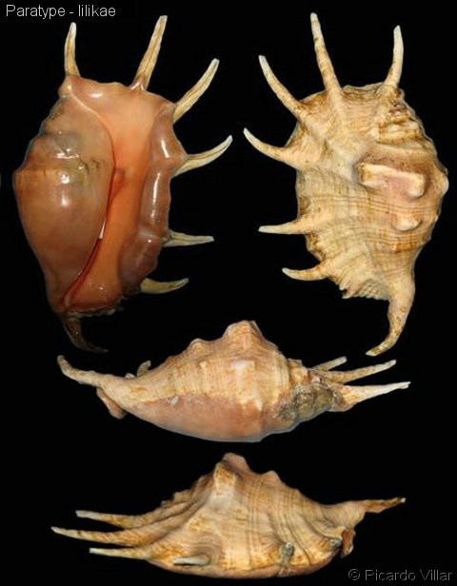
Lambis lilikae
Effectively a “recognised hybrid”: L. lambis x L t. sowerbyi
Paratypes
Images © gastropods.com

Slide 40
Harpago group
H. chiragra
“Everywhere else…”
H. arthriticus
H. rugosus
“Central Indian Ocean”
“Coral Sea”
“Philippines, South China Sea, Celebes Sea, Java Sea, Gulf of Thailand”

Slide 41
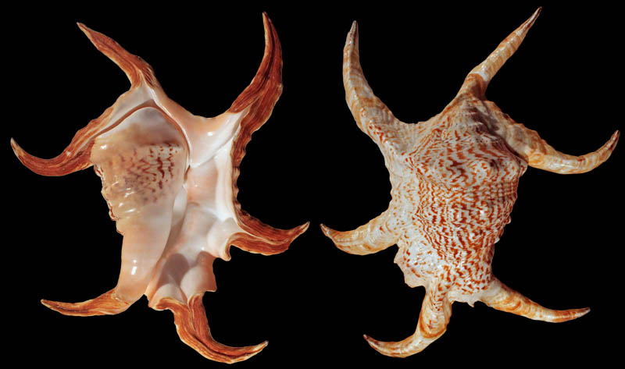
Harpago chiragra
Image © Andre Meredith

Slide 42
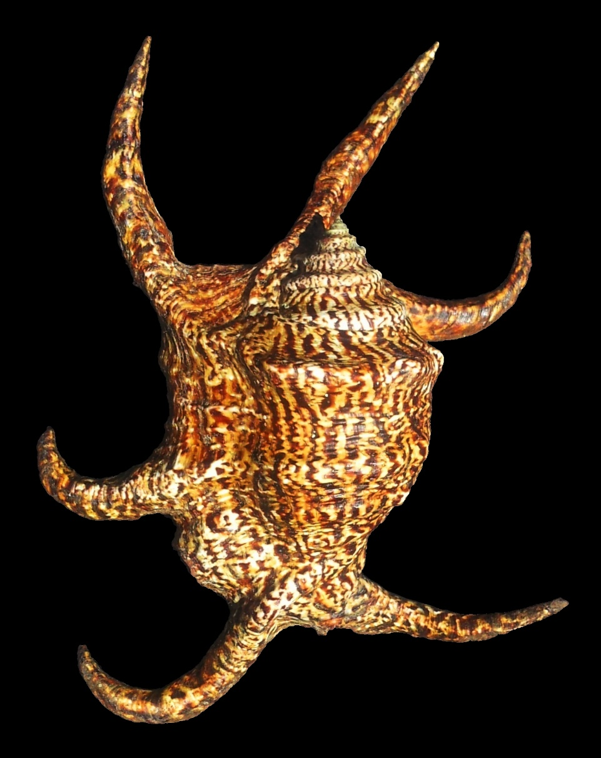
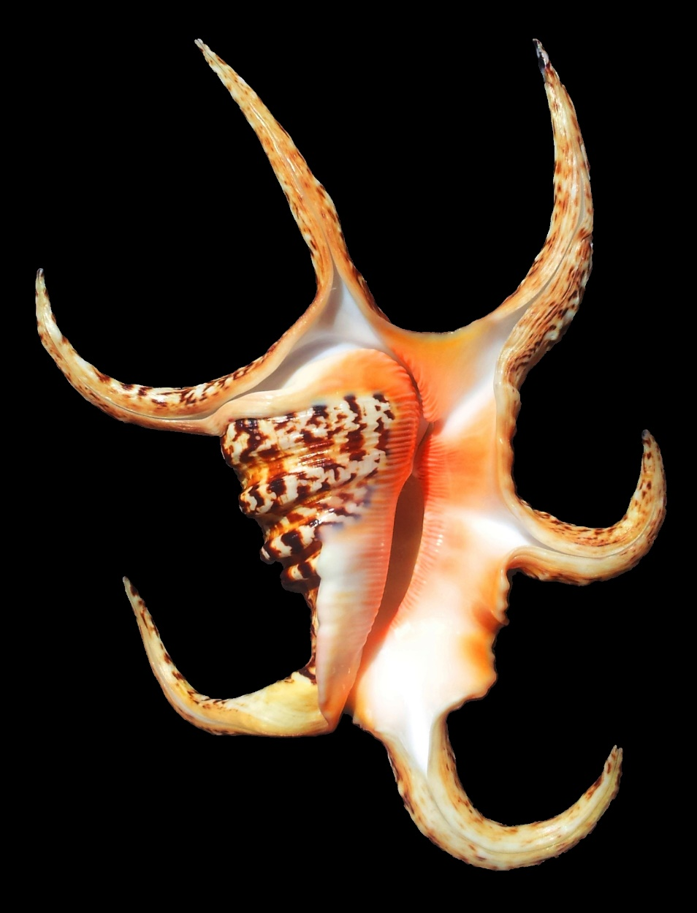
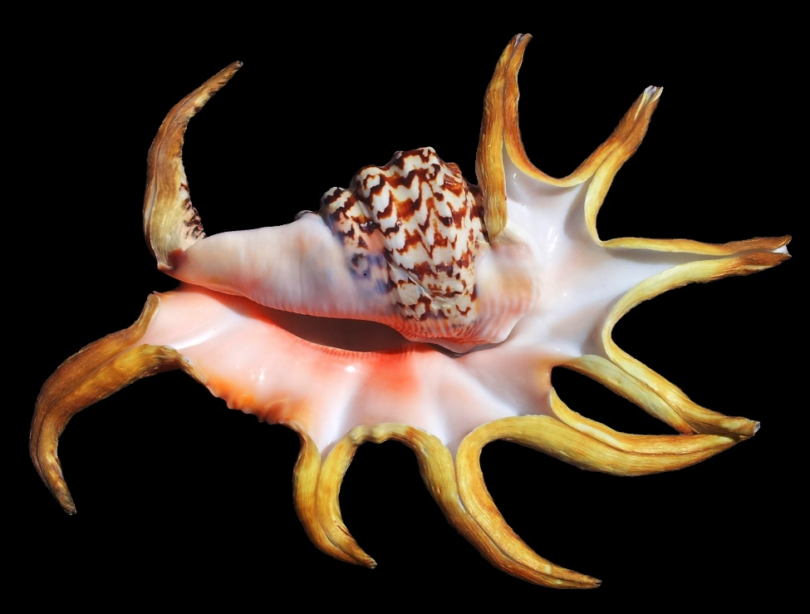
Harpago chiragra
Images © Andre Meredith

Slide 43
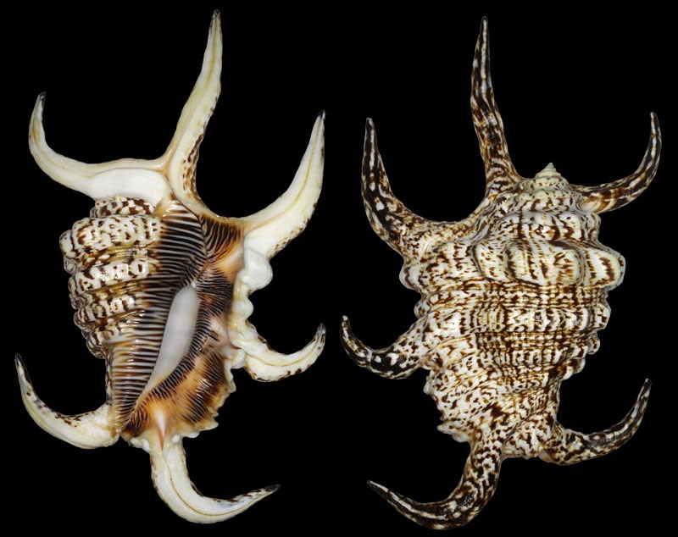
Harpago arthriticus
Image © Andre Meredith

Slide 44
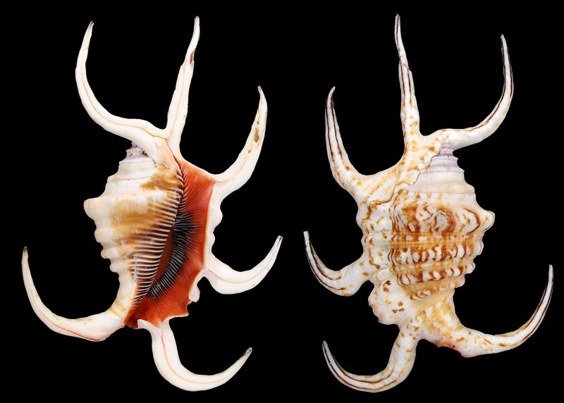
Harpago rugosus
WoRMS = Harpago chiragra rugosus
Image © Andre Meredith

Slide 45
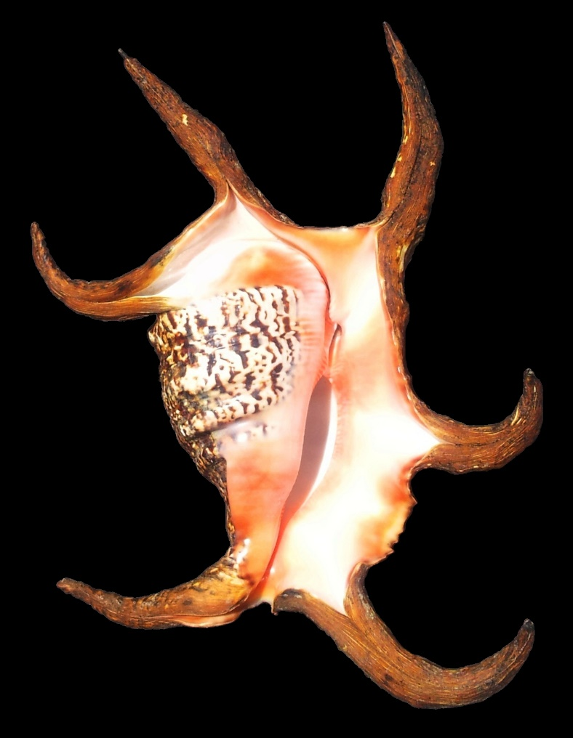
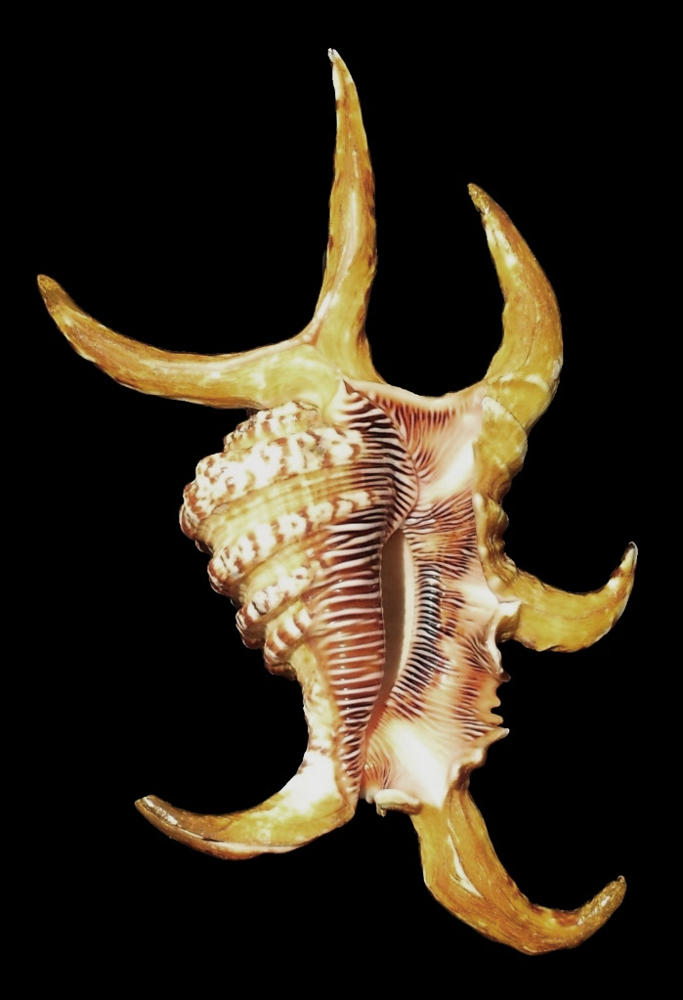
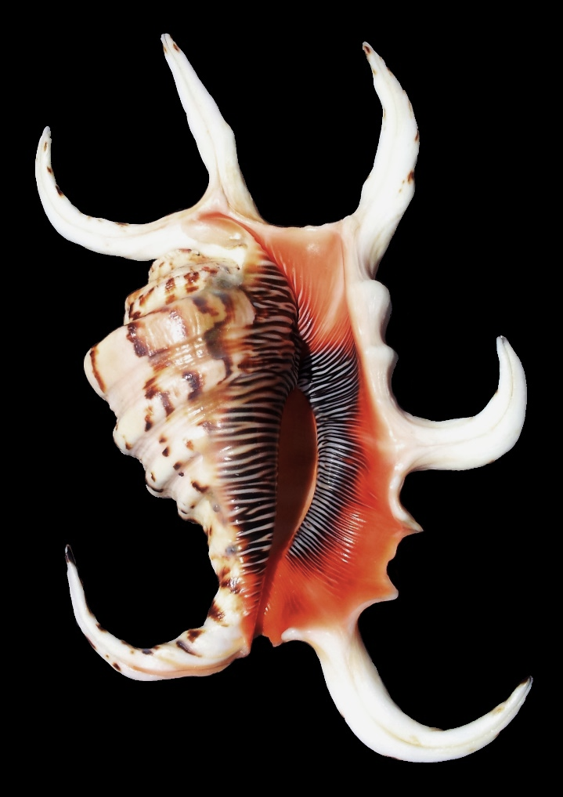
Harpago Group
H. chiragra
H. arthriticus
H. rugosus
Images © Andre Meredith

Slide 46
Ophioglossolambis digitata
Southern Philippines
Fiji - Samoa
Central East Africa

Slide 47
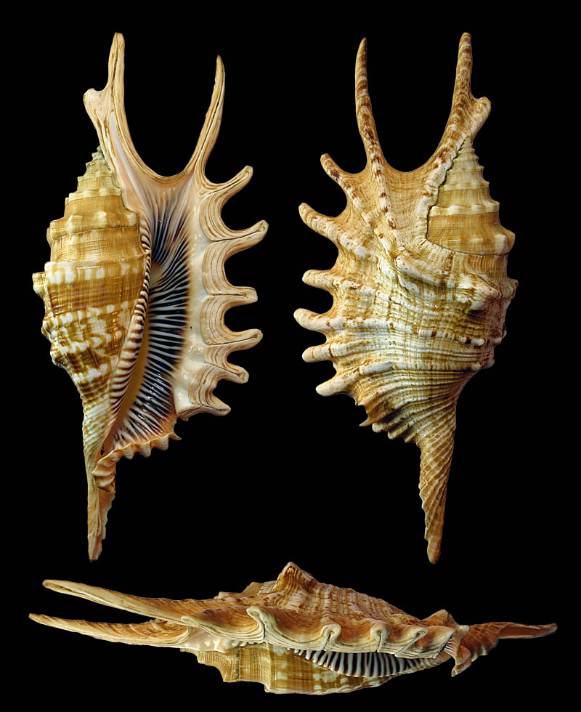
Ophioglossolambis digitata
vs
Image © stromboidea.de
L. millepeda

Slide 48
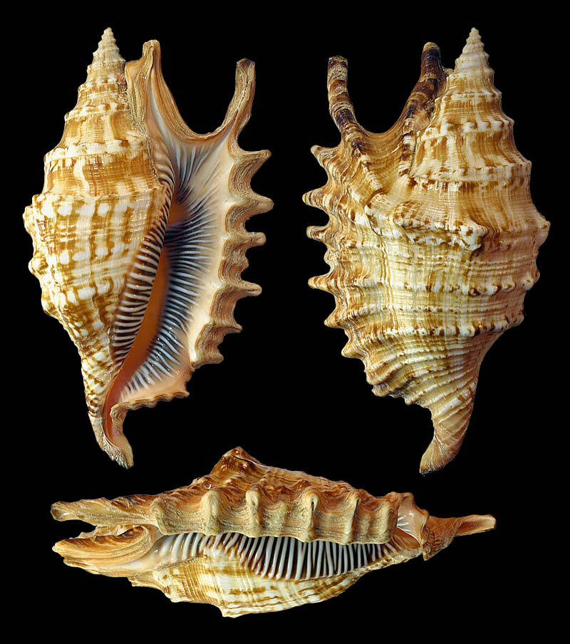
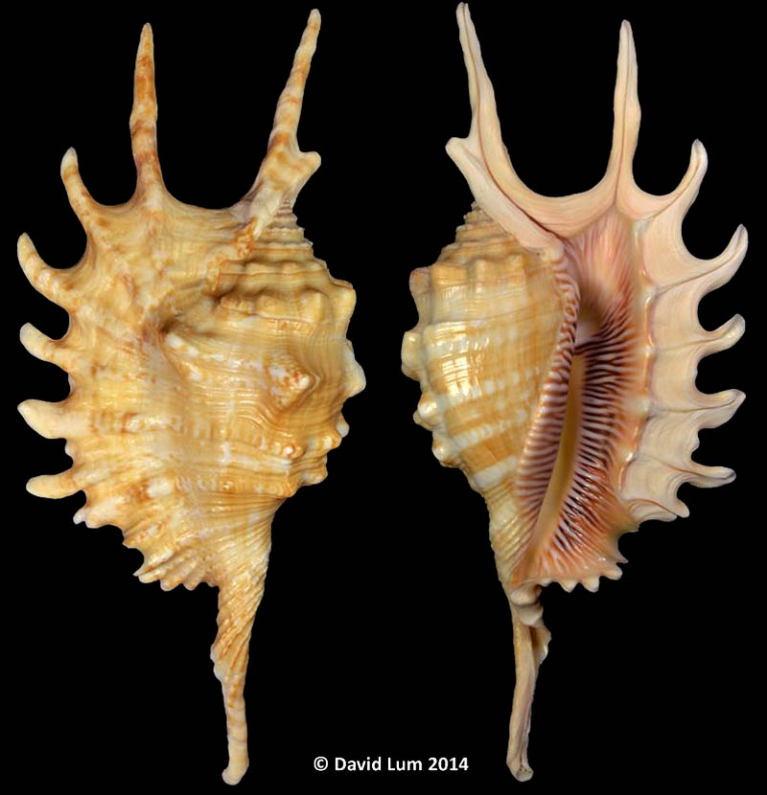
L. digitata f. crocea
Mauritius / St Brandon / Reunion
Shorter spire
Longer digits
typical
f. crocea
Images © stromboidea.de

Slide 49
Ophioglossolambis violacea
doubtful
“Mauritius”
(endemic)

Slide 50
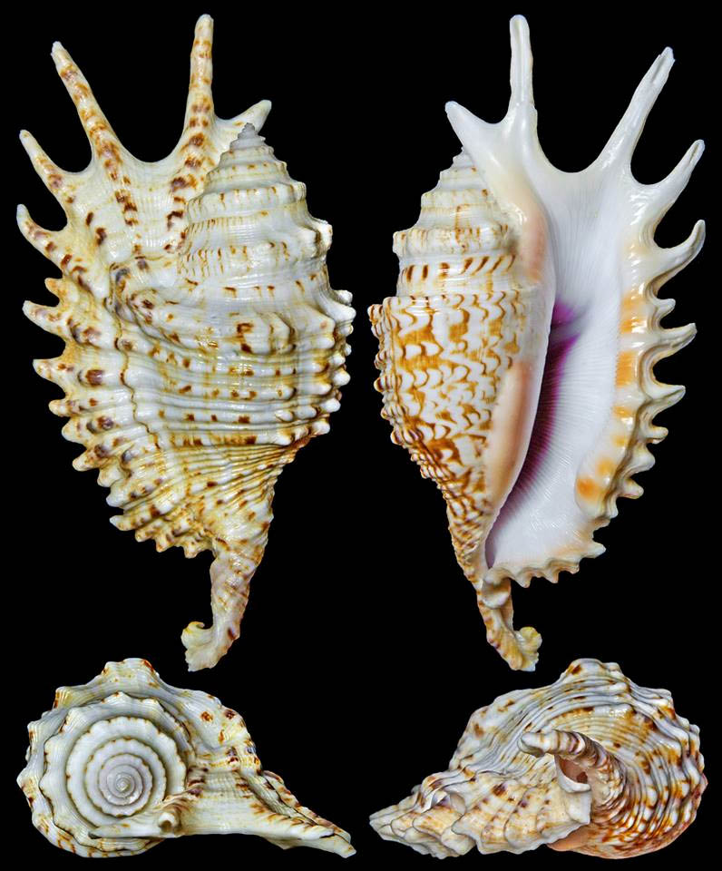
Ophioglossolambis violacea
Images © stromboidea.de

Slide 51
?

