Slide 1
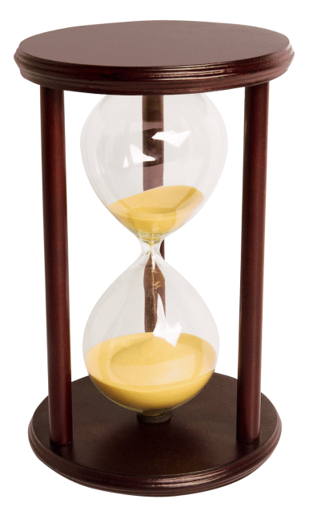
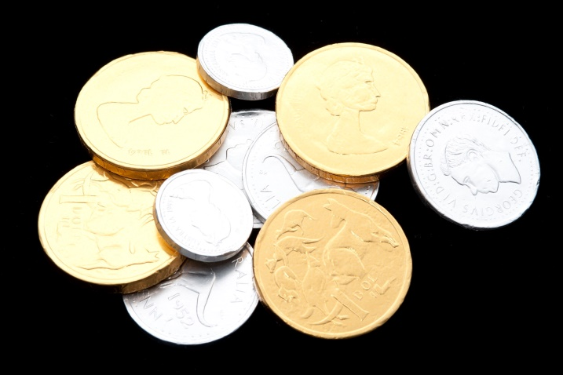
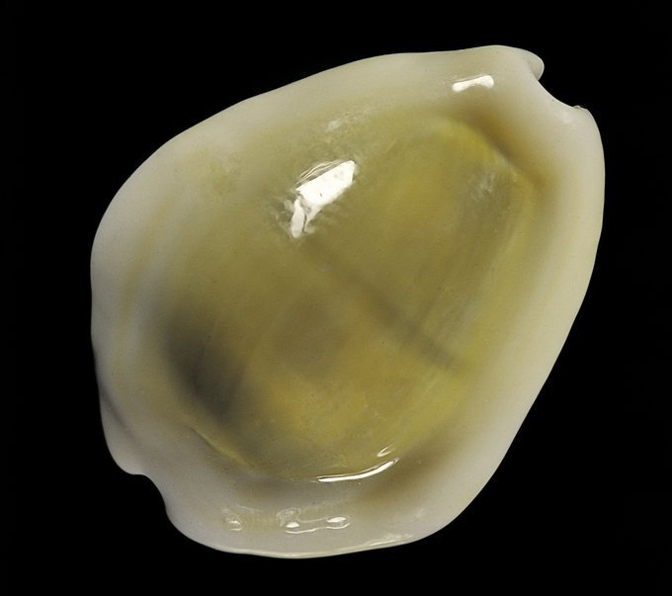
Shell Auctions
Andre Meredith

Slide 2
Auctions vs Fixed Prices
Two methods of “online purchasing”
Fixed Price purchasing.
Prices are fixed (not negotiable).
Immediate ownership.
Auction purchasing.
Prices may increase, depending on interest.
Delayed ownership.

Slide 3
Fixed Price Sites
Name | Address
Femorale | http://www.femorale.com/
Mar*a*Mar | https://maramarshells.com/
Patagonian Shells | New website being developed
Schooner Specimen Shells | https://www.schnr-specimen-shells.com/
Deep n Reef Shells | https://www.deepnreef.com/
Shell Dimension | http://www.shelldimension.com/
Atoll Specimen Shells | https://www.atollseashells.com/
Top Seashells | https://www.topseashells.com/
Shells Passion | http://www.shellspassion.com/
Bluewater Coast Marine Specimens | http://bluewatercoast.com.au/
Malacology Asia | https://www.malacology-asia.com/

Slide 4
Fixed Price Sites
Name | Address
Indo-Pacific Seashells | http://www.indopacificseashells.com/
Australian Seashells | http://www.seashells.net.au/
De Donder Shells | http://www.dedondershells.com/
Shell Brothers | https://www.shellbrothers.be/
Conchology Inc | https://www.conchology.be/
YHshells | http://yhshells.com/index.php
Shells.cz | https://www.shells.cz/
Lagrenadine | https://www.lagrenadine.com/
Werner Massier Specimen Shells | http://www.massier-seashells.com/
Caledonian Seashells | http://www.caledonianseashells.com/
Pututu Peruvian Specimen Shells | https://www.pututu.org/

Slide 5
Fixed Price Sites
Name | Address
Eaton’s Seashells | https://shop.eatonsseashells.co.uk/
Simon’s Specimen Shells | https://www.simons-specimen-shells.co.uk/
Algoa Bay Specimen Shells | http://www.algoabayshells.com/
rbridges.com | http://www.rbridges.com/
Worldwide Specimen Shells | http://www.worldwideconchology.com/worldwide/content.shtml
Shells Addict | http://shells-addict.com/
Many “fixed price dealers” have shut down their own sites and migrated to Auction Sites.

Slide 6
Why Auctions?
Less admin (website development/updating).
Larger volumes (attracts a lot of interest).
Assistance with dispute resolution.
New items listed regularly (finite “list times”).
Low starting amounts (generates interest).
Excitement…
There are bargains!

Slide 7
Auction Sites
Name | Address | Type
Conchology Inc | https://conchology.be/ | Mini Shell Auction ~25
Top Seashells | https://www.topseashells.com/ | Mini Shell Auction ~100
eBay | https://www.ebay.com/ | General Auction
delcampe | https://www.delcampe.net/en_GB/collectables/ | Collectibles Auction
George’s Auction | http://www.george-shells.com/auction.html | Midi Shell Auction (~ 1000)
Molluscan Auction | http://www.molluscanauction.com/ | Midi Shell Auction (~1000)
Shellauction.net | http://shellauction.net/ | Major Shell Auction ~75000

Slide 8
Conchology Inc

Slide 9
Conchology Inc

Slide 10
Top Seashells

Slide 11
Top Seashells

Slide 12
eBay

Slide 13
eBay
“seashells”

Slide 14
eBay
“specimen seashells”

Slide 15
eBay “Stores”
Il Posto delle Fragole 2
“postodellefragole2”

Slide 16
eBay “Stores”
tesouros do brasil
“shellsfrombrasil”

Slide 17
delcampe

Slide 18
delcampe

Slide 19
George’s Auction

Slide 20
George’s Auction

Slide 21
Molluscan Auction

Slide 22
Molluscan Auction

Slide 23
Molluscan Auction Basics
Not large (~1000 shells).
Based in Hong Kong.
Items loaded during course of Auction!
Two “auction types” hosted:
“Regular” Auction
“Open” Auction

Slide 24
Molluscan Auction Basics
Regular Auction:
Listings by site owner (Cillan Chan – “M Auction”).
Every two weeks.
Auction number starts with “E” (e.g. E181).
Starts on a Wednesday ~ 20:00 (8 PM).
Ends on the Sunday ~ 3:00 (3 AM).
~ 3.5 days.
Average starting bids.
Only best-quality specimens (usually).

Slide 25
Molluscan Auction Basics
Open Auction:
Listings by other dealers.
Irregular timings.
Auction number starts with “A” (e.g. A008).
Starts on a Thursday ~ 18:00 (6 PM).
Ends on the Sunday ~ 16:00 (4 PM).
~ 3 days.
Highly variable starting bids(dealer-dependent).
Only best-quality specimens (usually).

Slide 26
End of PART 1

