Slide 1
Shell Auctions
Start of Part 2

Slide 2
Shellauction.net
MOASA
75000

Slide 3
Shellauction.net

Slide 4
Shellauction.net

Slide 5
Shellauction.net
Login
User Pg
Families
Links
Contact
Account
Currency
Report
Feedback

Slide 6
Shellauction.net

Slide 7
Shellauction.net

Slide 8
Shellauction.net

Slide 9
Shellauction.net

Slide 10
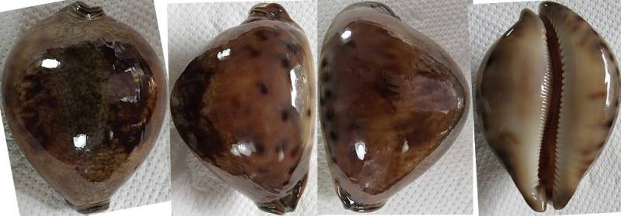
Shellauction.net

Slide 11
Shellauction.net
€2
€260

Slide 12
Shellauction.net

Slide 13
Shellauction.net

Slide 14
Shellauction.net Basics
Items listed by dealers.
Once a month.
Starts 2nd-last Wednesday of each month.
Starts ~ 21:00 (9 PM).
Ends ~ 21:00 (9 PM) a week later.
~ 7 days.
Items end at different times!
Varying starting bids + quality.

Slide 15
Auction Basics
Viewing is free, but…
… you must Register to participate!
Start and End times.
Starting bids/amounts.
Minimum bidding increments.
Your Max bid.
Dealer reputation.

Slide 16
Auction Basics
Closing time (the “moment of insanity”).
Payment methods.
Remember shipping and customs!
Shipping methods.
Reserve items!
Communications.
Post-auction negotiations/discounts.

Slide 17
Bidding to Win
What “shellbiddy” sees:
Min
bidding
increment = €1
What other bidders see:
“shellbiddy”
Max
€5
Paying
€4
“shellbiddy” winning @ €4
Autobid
€3
“some_other_dude”
€2
Paying
€1
“shellbiddy” winning @ €1
(first bidder)
Start

Slide 18
Tips
Don’t bid on everything – you might win it all!
Check your budget – bid within your means.
A bid is a contract – you must honour and pay.
Don’t be desponded if you lose.
Check dealer reputations (feedback system).
Check shell quality + read descriptions.
Communicate with dealers.
Always pay quickly.
Have shells reserved – saves on shipping.
Pre-set you max bids – don’t get carried away!

Slide 19
Shipping

Slide 20
Shipping
Method | Speed | Cost | Security | Convenience

Slide 21
Complicated?
Come bid with us!
No need to Register.
No need to create a Paypal account.
No need to converse with dealers.
No need to manage bids.
As long as you can email and EFT…

Slide 22
End of Presentation

